Slide 1
Structuring accessible forms
Rachele DiTullio, Senior Accessibility Engineer, Citizens

Slide 2
Rachele DiTullio (she/they)
Web developer for many years
Graduate school for Information Studies (UXD)
Learned accessibility and became a Certified Professional in Web Accessibility (CPWA)
Progressed from software engineering to accessibility engineering in 2021
Notes:
2019: Web Accessibility Specialist
2020: Certified Professional in Accessibility Core Competencies
IAAP: International Association of Accessibility Professionals

Slide 3
Agenda
Creating form fields
Grouping similar fields
Marking required fields
Validating data formats
Handling form errors

Slide 4
Web Accessibility
Web accessibility is the extent to which a website or web application can be used by disabled people.
Less
More

Slide 5
Accessibility is not a technical problem to be solved
It’s a human one.
We must understand the ways disabled people access and use digital information.
Disabled people will try to use your application.
Who are you willing to exclude?

Slide 6
Accessibility must be baked in
Notes:
Should start in requirements gathering should not be left to the end or for QA to do

Slide 7
Semantic Markup
Native HTML elements first
…then ARIA.

Slide 8
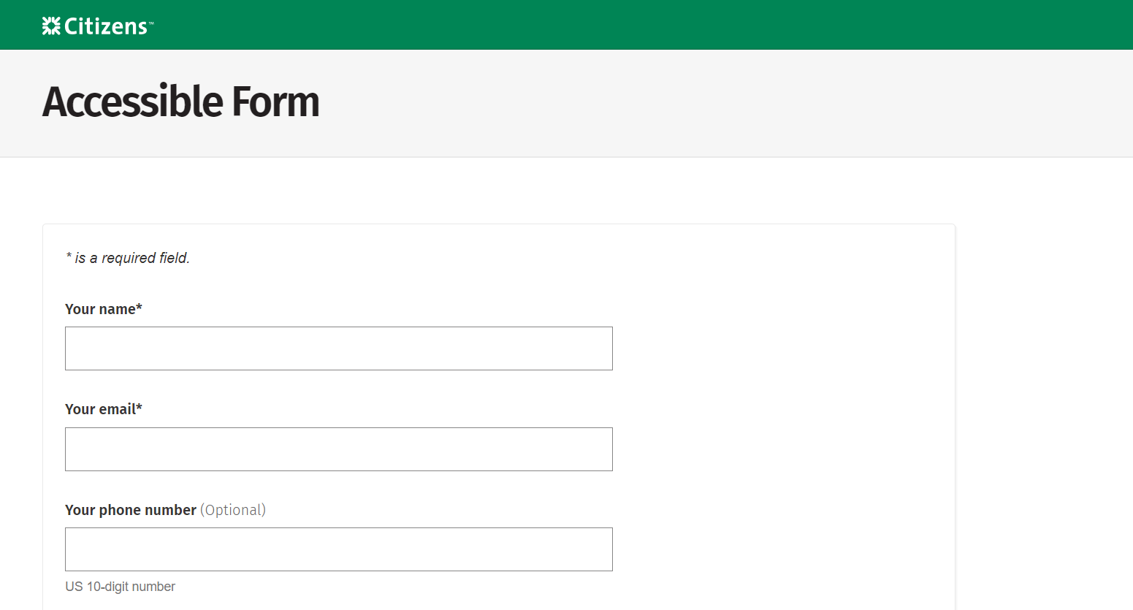
Accessible form example webpage

Slide 9
Creating Form Fields
Labels provide visible and accessible names to form inputs.
for and id attributes programmatically link labels and inputs.

Slide 10
Label with Input
<label for="name">Your name</label>
<input type="text" id="name" name="name">

Slide 11
Input Types
<input type="email" id="email" name="email">
<input type="radio" id="yes" name="customer">
<input type="checkbox" id="checking" name="checking">
Other types include search, url and tel.
Notes:
HTML5 input types: https://developer.mozilla.org/en-US/docs/Learn/Forms/HTML5_input_types

Slide 12
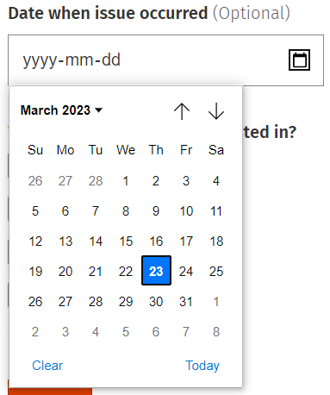
Input Type: Date
<input ... id="date" type="date" name="date">
Notes:
Date picker has partial screen reader and voice support: https://a11ysupport.io/tech/html/input(type-date)_element

Slide 13
autocomplete attribute
<input type="text" id="name" name="name" autocomplete="name">
Notes:
Autocomplete attribute: https://developer.mozilla.org/en-US/docs/Web/HTML/Attributes/autocomplete

Slide 14
Single Select
<select id="why" name="why">
... <option value="website">Website question</option>...</select>

Slide 15
Grouping Similar Fields
Fieldset groups related fields, often radio buttons and checkboxes.
Legend provides a label for the grouped controls.

Slide 16
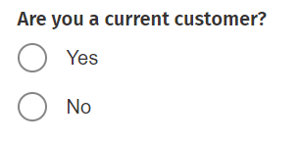
Fieldset with Legend
<fieldset>
<legend>Are you a current customer?</legend> ...
</fieldset>

Slide 17
Radio Buttons
<label for="yes"> <input name="customer" type="radio" id="yes">Yes</label> <label for="no"> <input name="customer" type="radio" id="no">No</label>

Slide 18
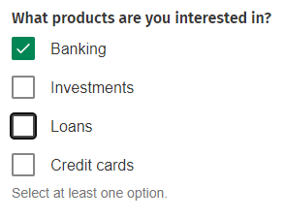
Checkboxes
<label for="banking"> <input type="checkbox" id="banking" name="banking" ...> Banking</label>
<label for="investments"> <input type="checkbox" id="investments" name="investments" ...>
Investments</label>

Slide 19
Marking Required Fields
Provide a visible indication of required fields.
Include either the required or the aria-required="true" attribute to programmatically mark a field as required.

Slide 20
required & aria-required
<p>* indicates required field.</p>
...
<input type="text" required ...>
or
<input type="text" aria-required="true" ...>
Notes:
Authors SHOULD NOT use the aria-required="true" on any element which also has a required attribute.
https://w3c.github.io/html-aria/#att-required
Using required will enable browser validation.

Slide 21
Required Radio Buttons and Checkboxes
There is no HTML way to make groups of radio buttons or checkboxes required.
Use server-side scripting (JavaScript fallback) to validate if a radio button or checkbox has been selected from a group.
Notes:
Works for most input types but not radio buttons or checkboxes.

Slide 22
Validating data formats
Add the pattern attribute to the <input> element and use a regular expression to define the data format.
Include help text indicating the valid data format, e.g. US 10-digit number.

Slide 23
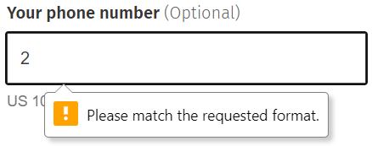
pattern Attribute
<input pattern="([0-9]+(-[0-9]+)+)"...>
Notes:
Regex generator: https://regex-generator.olafneumann.org/

Slide 24
aria-describedby Attribute
<input type="tel" ...
aria-describedby="help-01">
...
<div id="help-01" ...> US 10-digit number</div>

Slide 25
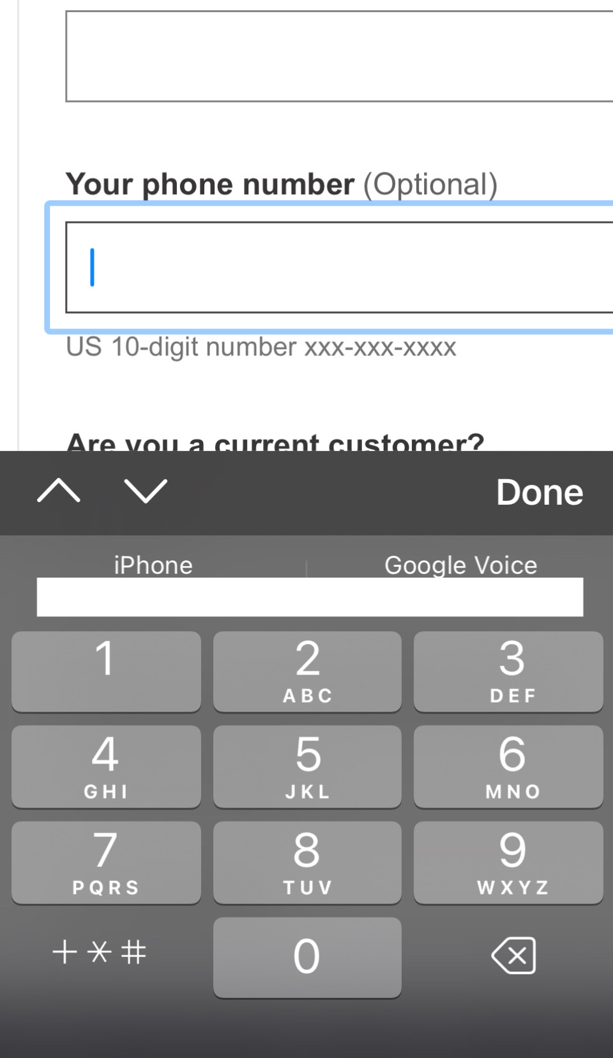
inputmode Attribute
<input type="tel"
inputmode="tel" ...>
Notes:
Other types: numeric, email, search, url
https://developer.mozilla.org/en-US/docs/Web/HTML/Global_attributes/inputmode

Slide 26
novalidate Attribute
<form novalidate ...>
...
<input type="text" required ...>
...
</form>
Notes:
Novalidate disables browser validation for input types like email format, pattern attributes and required fields.

Slide 27
Handling Form Errors
Include the aria-invalid="true" attribute on form fields in error.
Provide a visible error message and programmatically link it using the aria-describedby attribute.
Notes:
Avoid default field validation: https://adrianroselli.com/2019/02/avoid-default-field-validation.html

Slide 28
aria-invalid Attribute
<input type="email" ... aria-required="true" aria-invalid="true"
aria-describedby="error-02">
<div id="error-02"><svg role="img" aria-label="Error:">...</svg>Email format is address@domain.com.</div>

Slide 29
Error Messages
Error messages must be visible, persistent and close to the field in error.
Don’t rely on color alone to convey errors. Include an icon with “error” as the alt text.

Slide 30
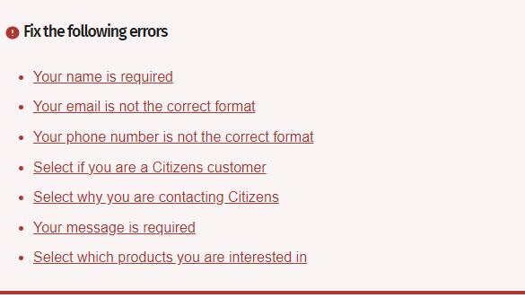
Group Error Messages

Slide 31
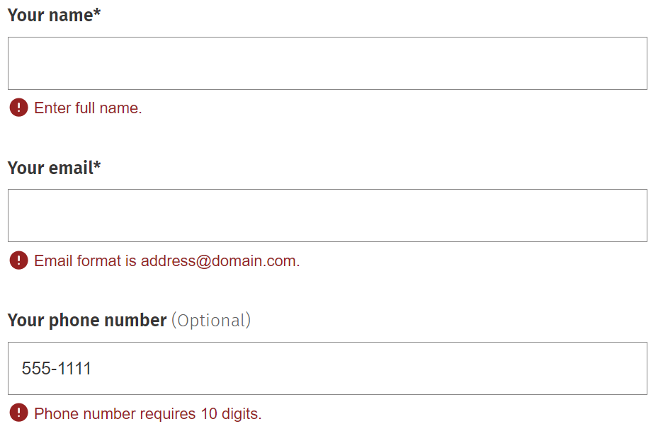
Example Error Messages

Slide 32
Summary
Verify each <input> element has a defined type, id attribute, name attribute and autocomplete attribute (if needed), linked to <label for="id">.
Group related fields such as radio buttons and checkboxes using <fieldset> and <legend> elements.
Provide data format requirements using the pattern attribute.
Mark required fields visually and programmatically.
Add aria-invalid="true" to fields in error; programmatically link help and error text.

Slide 33
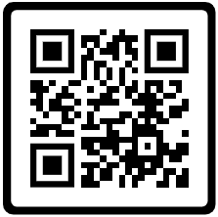
Thank you
Rachele DiTullio, Senior Accessibility Engineer, Citizens
Email: rachele.ditullio@protonmail.com
LinkedIn: https://www.linkedin.com/in/racheleditullio/
Twitter: @RacheleDiTullio
Mastodon: @racheled@mastodon.social
Slides: https://racheleditullio.com/

