Slide 1




The WHAT, HOW, & WHY of Accessibility
Wesley Estes (Accessibility Engineer - Vispero/TPGi) Rachele DiTullio (Senior Accessibility Engineer - Citizens)
May 14, 2026

Slide 2
Agenda
Introductions
WHAT do you mean my content isn’t Accessible?
WHAT is Accessibility?
WHAT do we consider for digital Accessibility?
WHAT common scenarios do we find ourselves in?
HOW do people with disabilities interact with digital content; What’s their experience?
HOW desktop/laptop users interact with Web content
HOW do disable people use mobile devices to interact with native mobile apps?
WHY does this matter?

Slide 3
Introductions

Slide 4
WHAT do you mean my content isn’t Accessible?

Slide 5
WHAT do you mean my content isn’t Accessible? (slide)
Maybe you're new to accessibility?​
You've heard it mentioned, or listed as a deliverable requirement, but don't really understand what that means, find it confusing, and are already feeling overwhelmed at work as it is.​
This isn't uncommon; many people are truly interested in making things accessible but lack the knowledge or training to make educated decisions regarding accessibility in their design or development choices.
The reality is you simply don’t know what you don’t know, and that’s ok, all knowledge starts with ignorance.
This presentation will give you some perspectives to keep in mind, so your projects can advance to the next level and include accessibility​ considerations throughout from the start.
The technical specifics for implementing these considerations are too far reaching to include in this presentations scope, but WHAT accessibility considers, HOW these different users interact with your content, and WHY that experience needs to be considered early and often during design and development for the best experience will remain in the back of your mind for years to come!

Slide 6
WHAT is Accessibility?

Slide 7
WHAT is Accessibility? (slide)
Something being created with Accessibility in mind doesn't mean YOU can access the content in question with your specific abilities and technology; It means EVERYONE can access the content in question regardless of their disabilities or technical limitations.​
A very close, but separate, cousin to Accessibility is Usability (UI/UX). This is also important to consider but it is an entirely separate consideration which happens to overlap Accessibility in many areas. ​
Accessibility focuses on whether things can be accessed by disabled people, while Usability focuses on whether things can be used with a positive experience. ​
It's easy to assume that the user you're designing/developing for is just another version of you. If you have great eyesight, dual monitors, a gaming mouse, and high-speed internet everywhere you go... there’s a good chance that's the same user you envisioned during design and development​.
In reality though, there are A LOT of different types of people out there trying to access your content in A LOT of different ways.

Slide 8
WHAT do we consider for digital Accessibility?

Slide 9
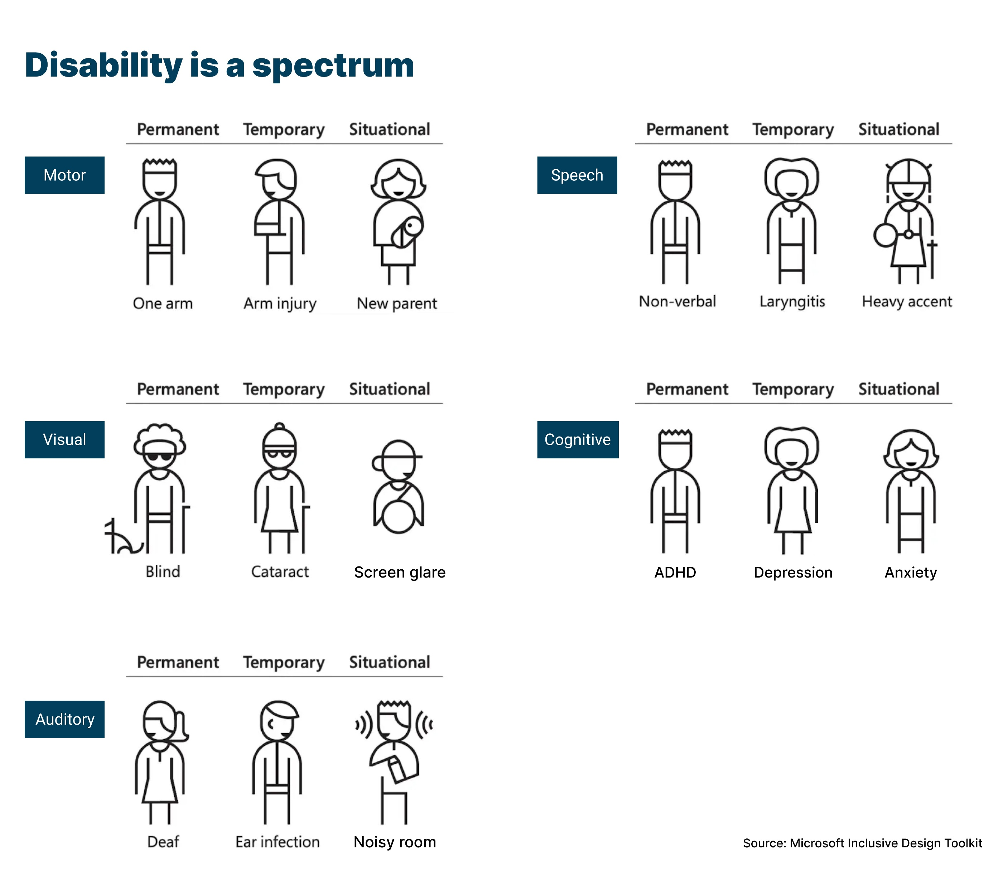
Digital Accessibility Considers 5 Main Areas
Vision:
Blind, Color Blind, or Low-Vision
Hearing:
Deaf/deaf, or Hard of Hearing
Speech:
Non-Verbal, or Speech Difficulties
Mobility:
Physical Disabilities, Parkinson’s, Tremors, or Unable to Use a Mouse
Cognitive:
ADD, Autism, Anxiety, Short-Term-Memory, Dyslexia, or Seizure disorders

Slide 10
WHAT Common scenarios do we find ourselves in?

Slide 11
WHAT Common scenarios do we find ourselves in? (slide)
Usually, when we get called in to do an audit or consultation, the team has gone all the way through their SDLC. From design to development, to QA, and all the way into production; either without thinking about accessibility at all, or assuming it's some sort of "formality" that has a "quick fix" and a rubber stamp from some other team that’s not their concern​.
This leads to deserved kudos (credit where credit is due) for putting so much thought and effort into the current design and implementation of the product, it looks great... for users like yourselves; but has issues for other users. We aren’t here to tear anyone down, just help iteratively improve.
At this point in the process, we hand over documentation with hundreds of pages of failures, remediation advice, screen shots, etc...​
Jaws drop; The deer in headlight eyes start; Every PM in the room starts sweating; designers and developers alike both start pointing fingers; The risk team’s stomach turns to knots thinking about client complaints and potential legal repercussions… ​
The accessibility veil has been ripped off and a whole world of considerations and requirements the team possibly didn't know existed has suddenly appeared.
It’s ok, accessibility is a journey, we can get better; and it starts with understanding the experience.

Slide 12
HOW do people with disabilities interact with digital content; What’s their experience?

Slide 13
Environment: Desktop/Laptop vs Mobile Devices, Web vs Native Mobile
Tooling Differences – Desktop/laptop users have different software available than mobile users.
Browsers are similar (e.g. Chrome, Firefox, Safari) but have subtle differences in how they expose the accessibility tree.
Screen Readers are different. Desktop/laptop uses JAWS (Windows), NVDA (Windows), or VoiceOver (MacOS); while mobile uses Talkback (Android) or VoiceOver (iOS).
Environment and Input – Desktop/laptop users interact differently than mobile users.
Larger landscape displays vs smaller portrait displays
Keyboard/mouse vs touch/gesture inputs
Different OSes, different limitations – Web is a very different environment than native mobile
Desktop/laptops use Windows, MacOS, and Linux; Native mobile uses Android and iOS.
Web browsers can have an overwhelming number of ways to present information. Comparatively, native mobile functionality is sometimes rather limited and isn’t always 1:1. This means the experience can look and feel similar on Web, Android, and iOS apps, but the way they are each coded MUST be uniquely considered for each environment.

Slide 14
HOW desktop/laptop users interact with Web content

Slide 15
Common Scenarios: Low-Vision
Color contrast is too low to read text or make out graphics.
Text or images are too small for them to read or easily make out.
Related data – such as labels and inputs – are located far away from each other, requiring significant panning/scrolling.

Slide 16
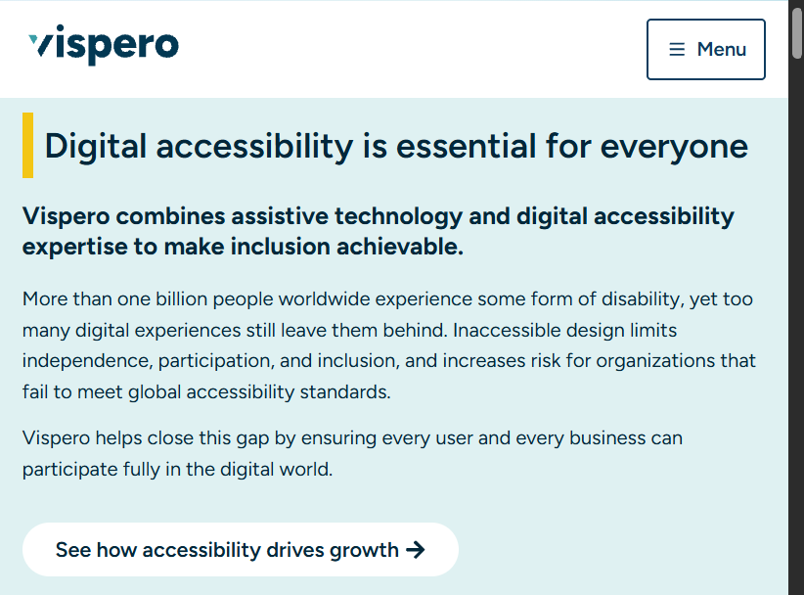
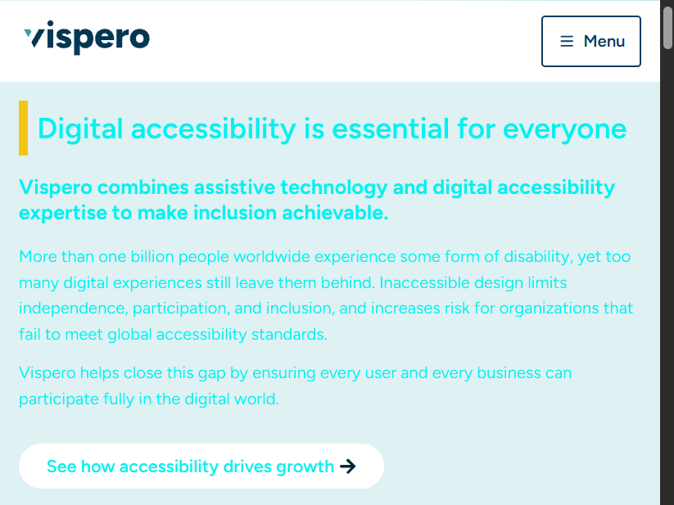
Experience: Low-Vision
Text with low contrast
Good Contrast
Bad Contrast

Slide 17
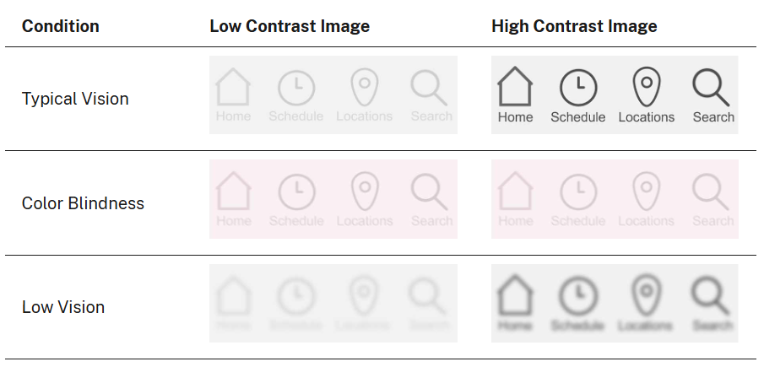
Experience: Low-Vision (cont.)
Images with low contrast source: section508.gov
Low vs High Contrast Images for Typical, Color Blind, and Low Vision Users

Slide 18
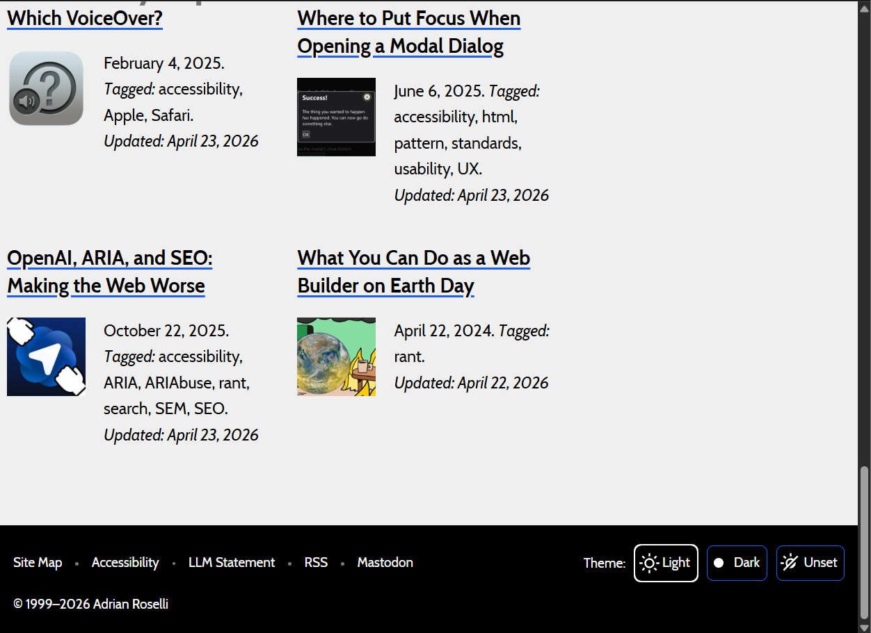
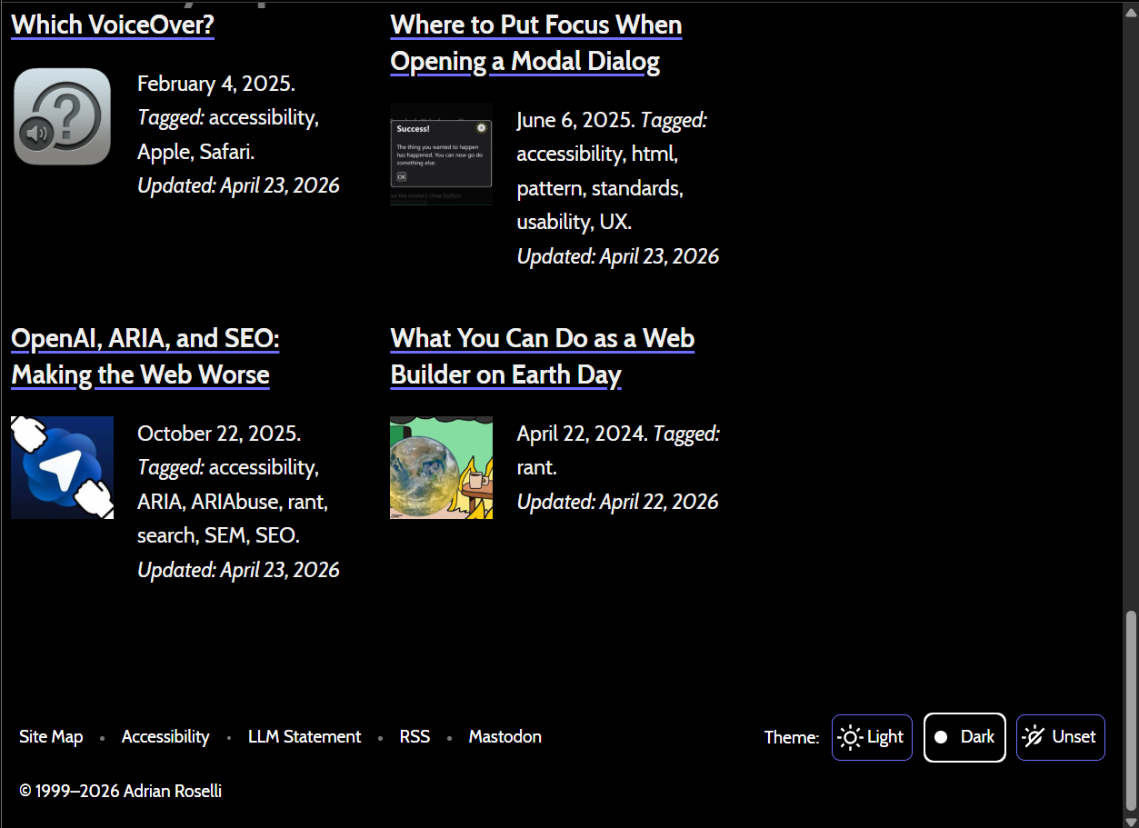
Experience: Low-Vision (cont.2)
Light mode vs Dark mode source: adrianroselli.com
Light Mode
Dark Mode

Slide 19
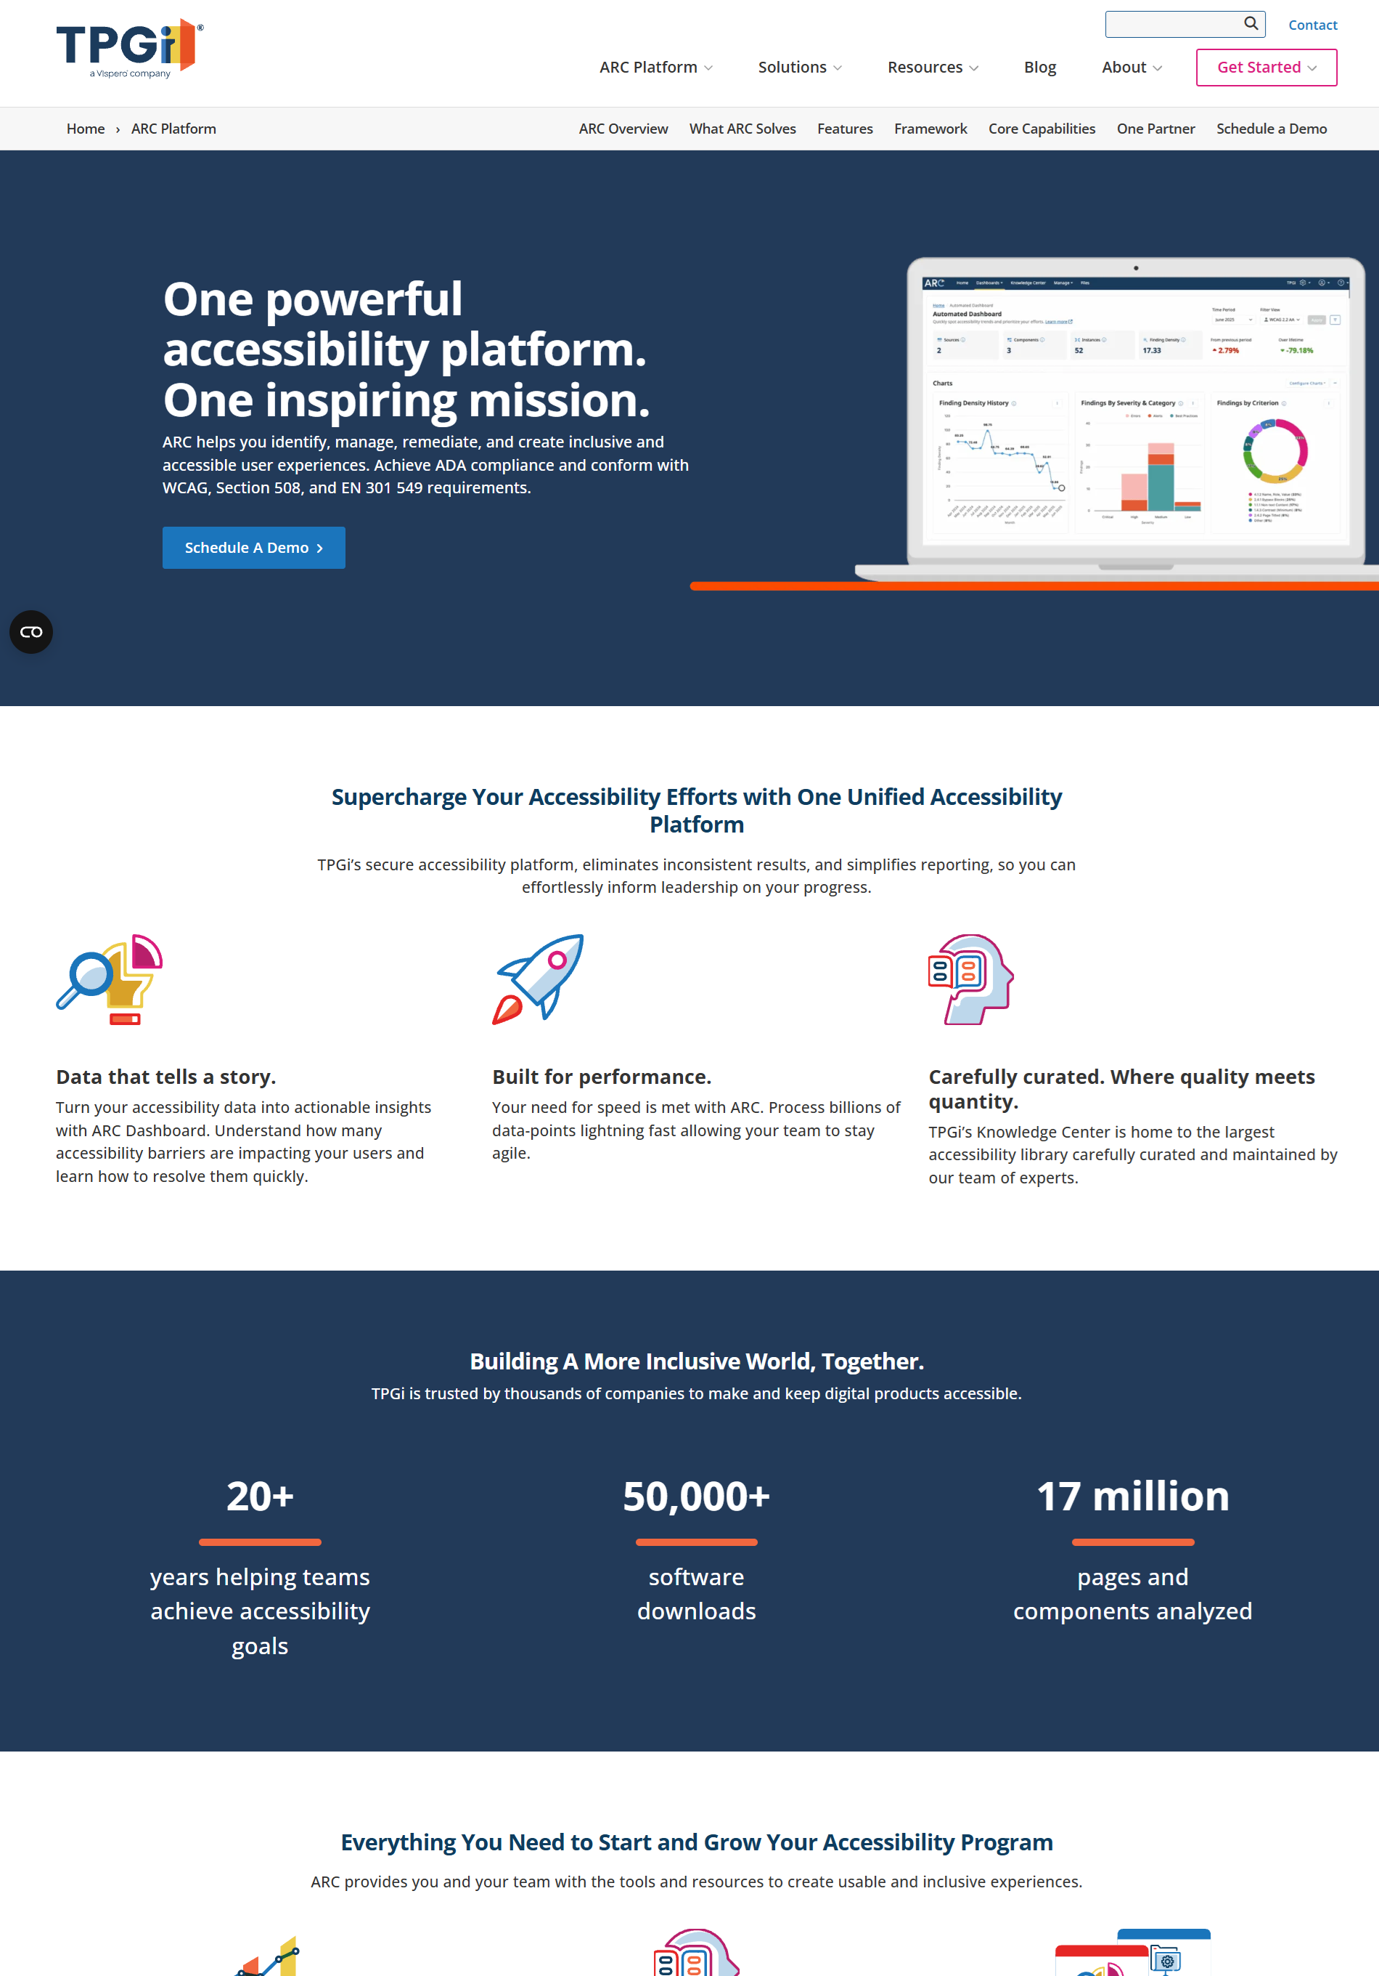
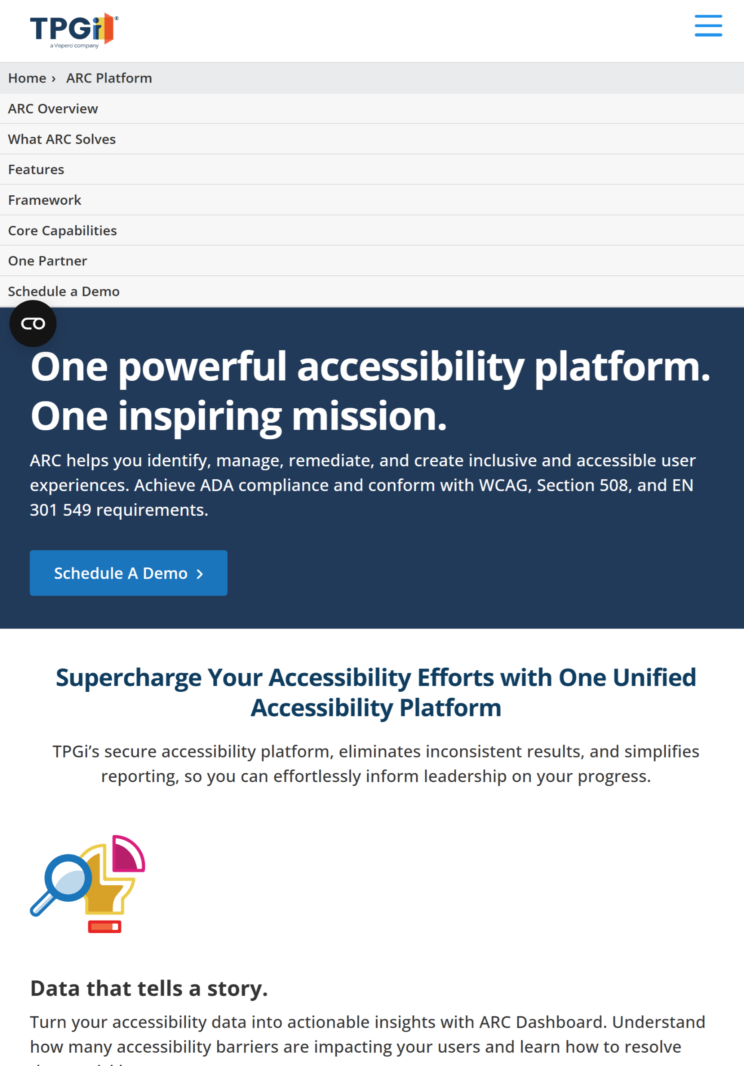
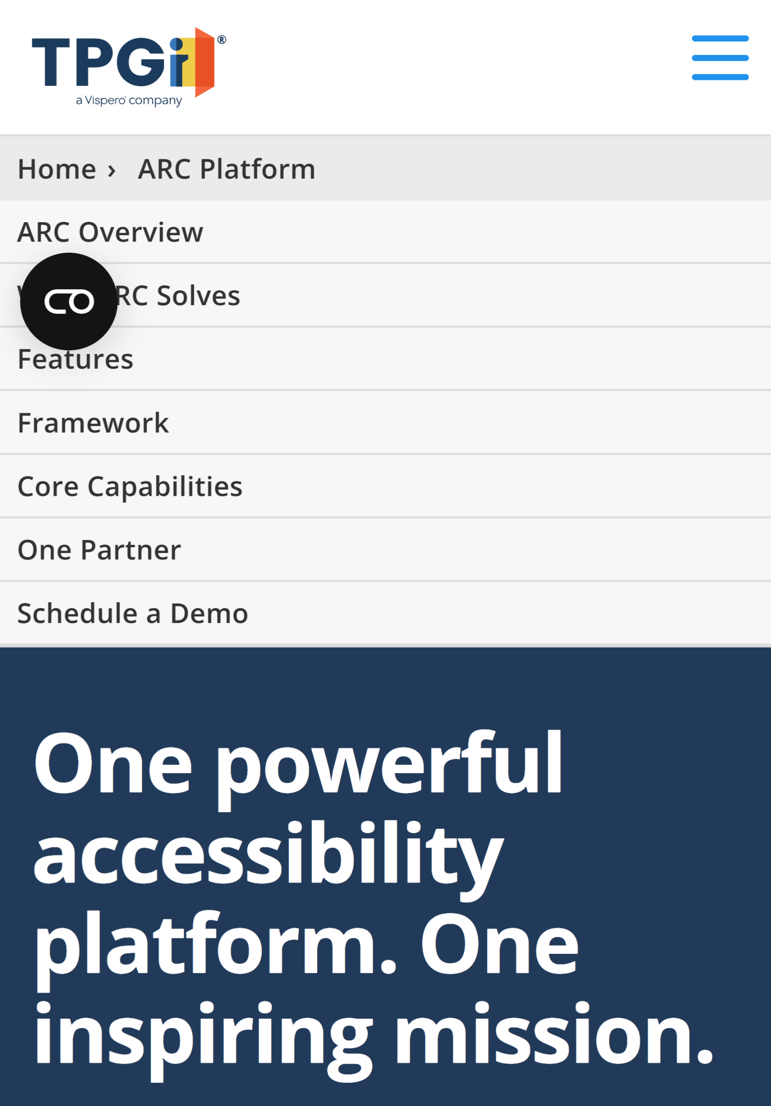
Experience: Low-Vision (cont.3)
Content too small to make out Tool: Browser Zooming (e.g. 200%, 400%)
Page at 100% Zoom
Page at 200% Zoom
Page at 400% Zoom

Slide 20
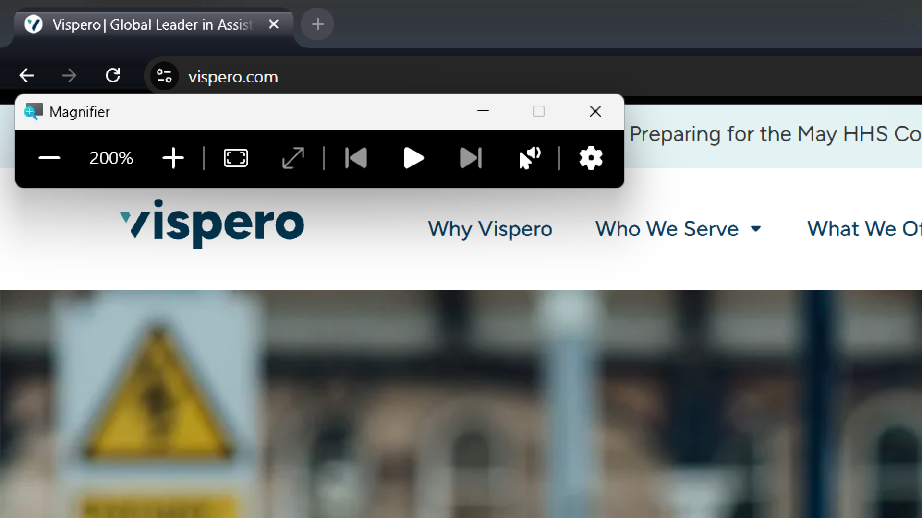
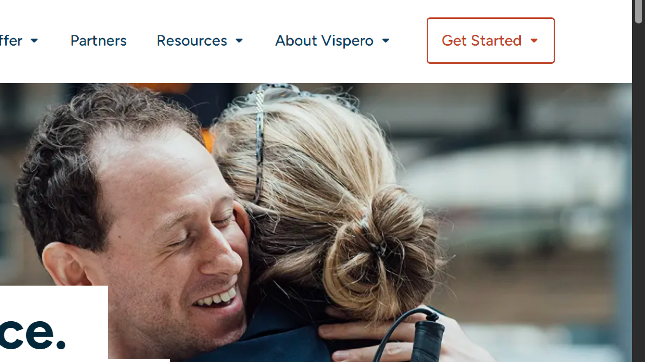
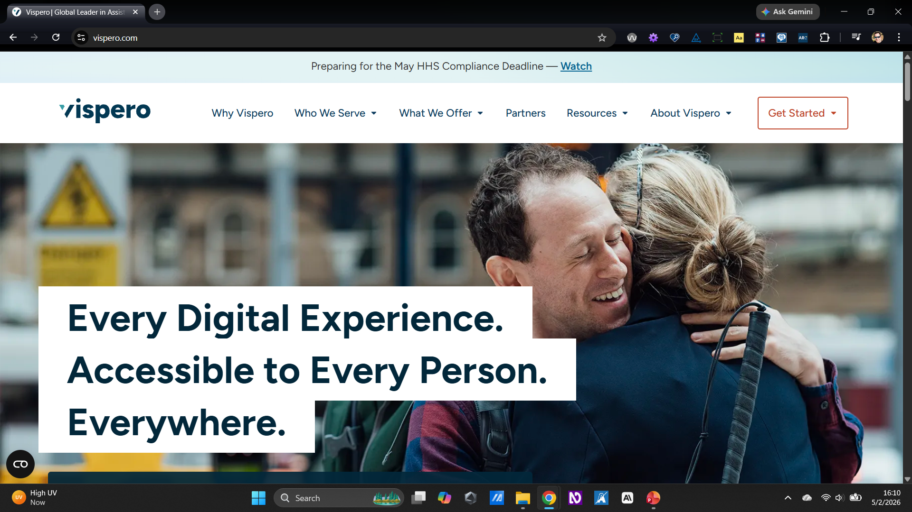
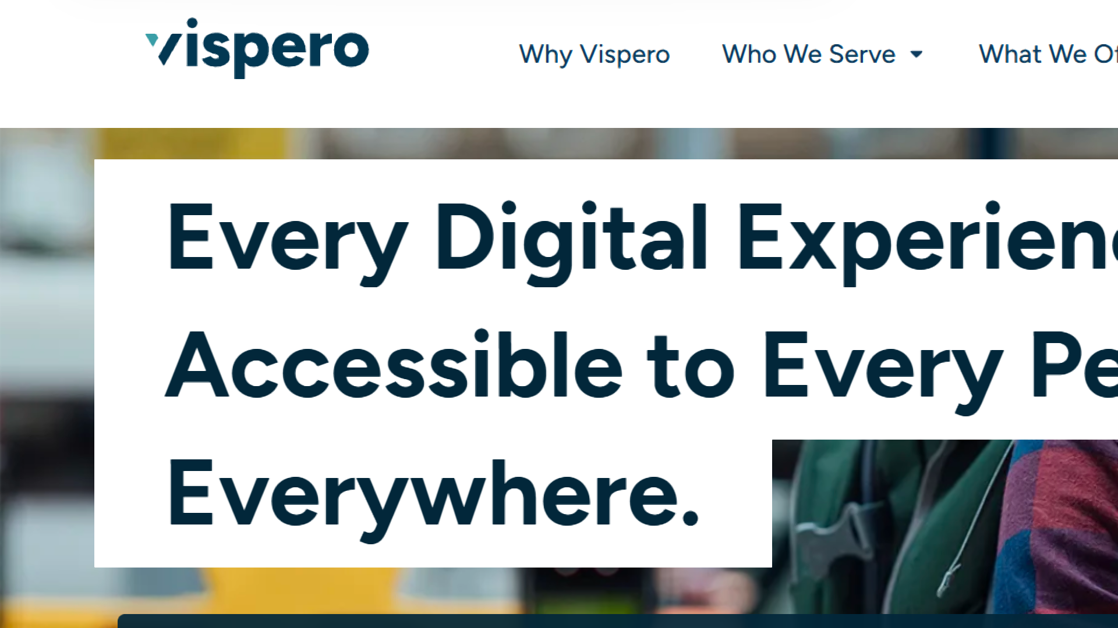
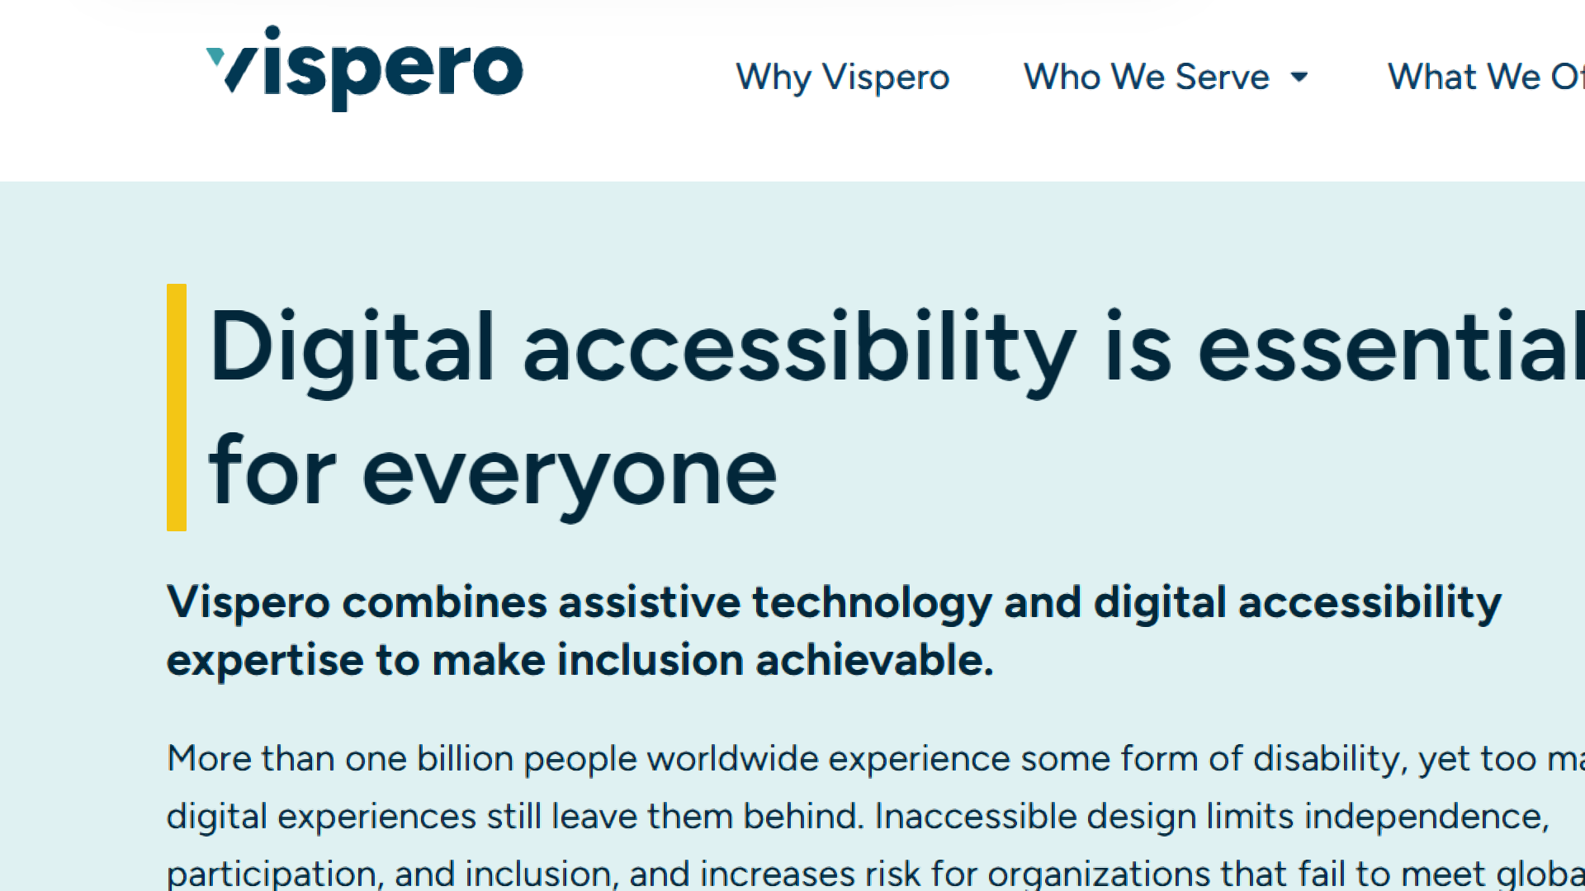
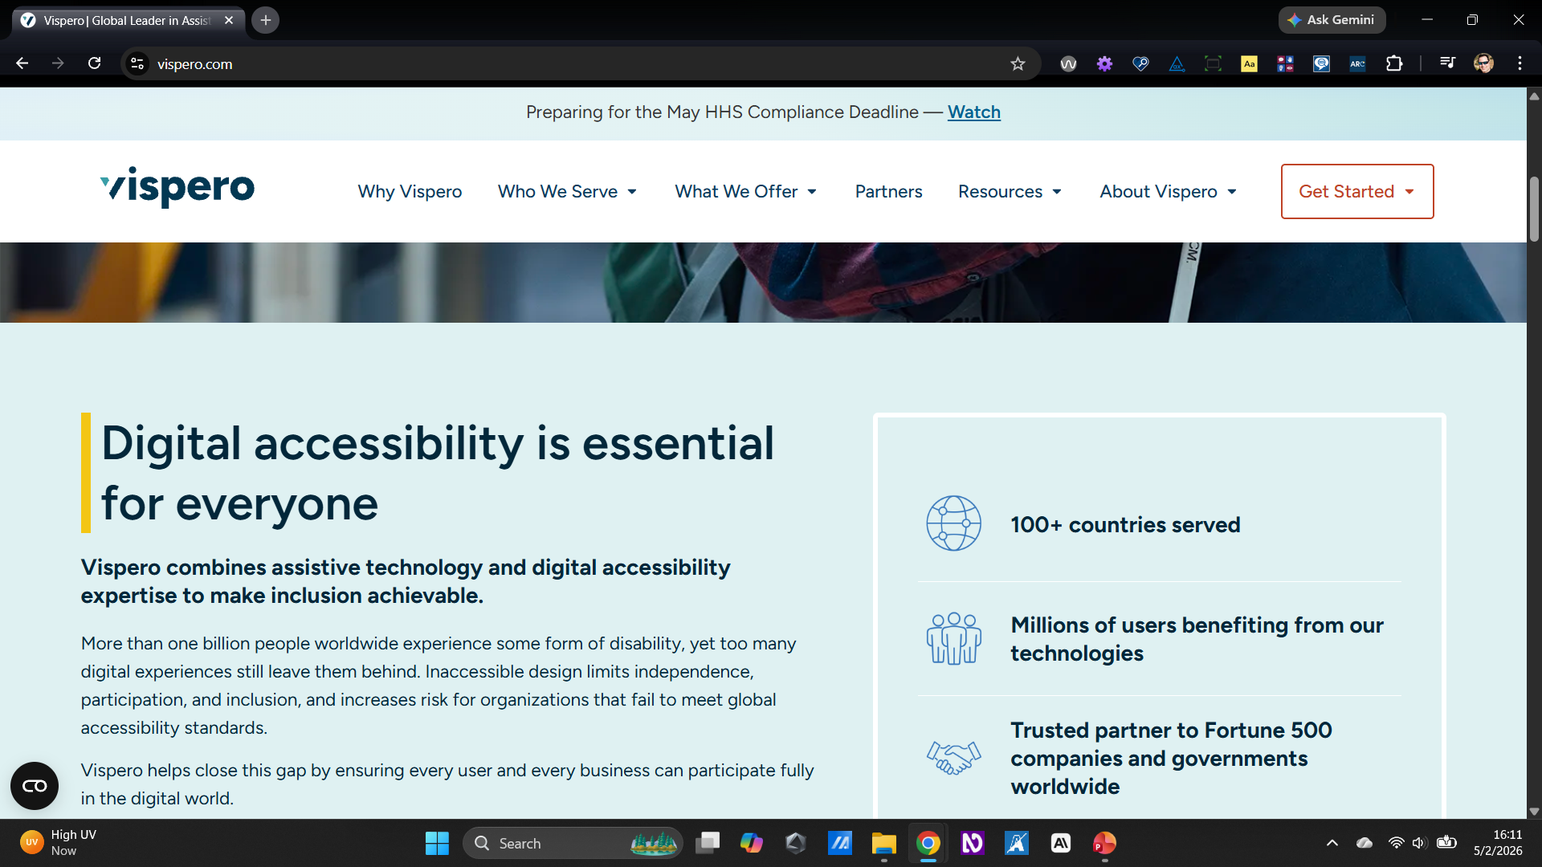
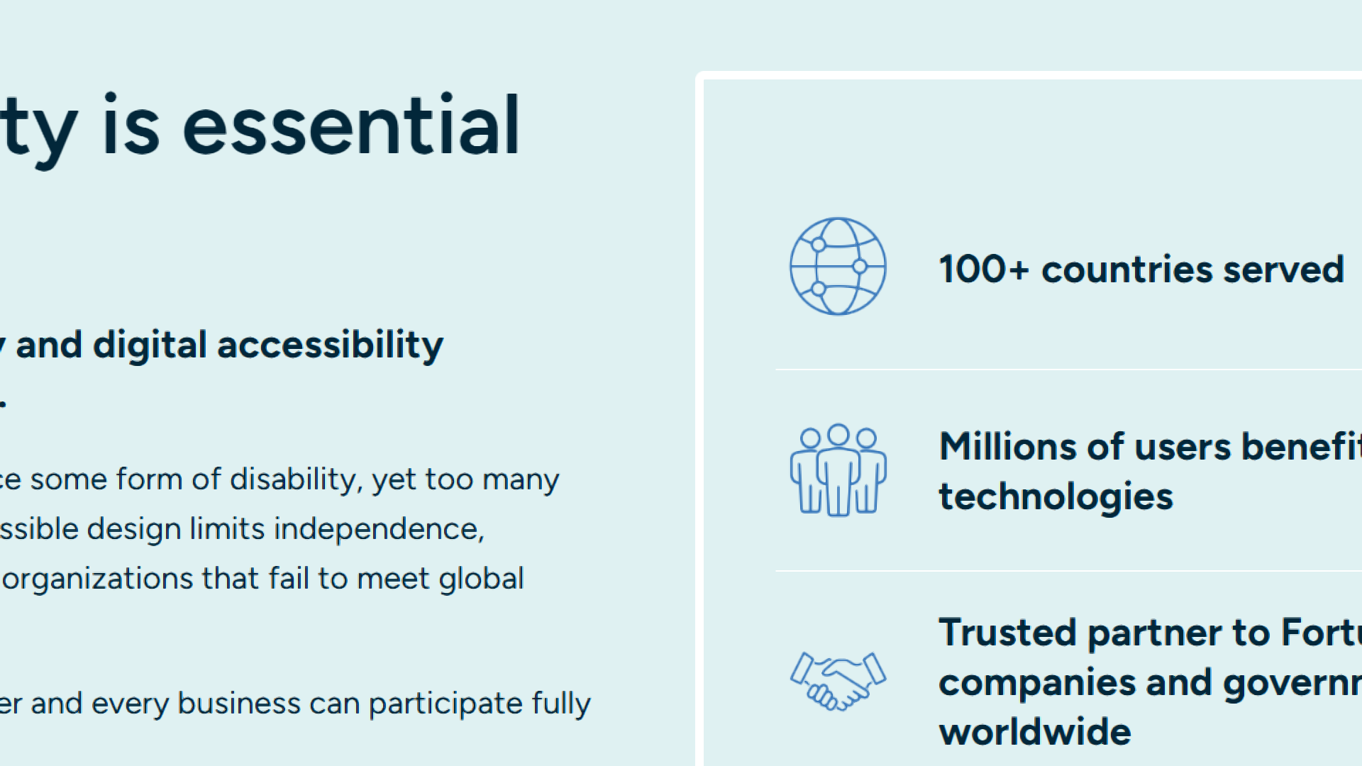
Experience: Low-Vision (cont.4)
Using a Screen Magnification Tool: Screen Magnifier (e.g. ZoomText, Windows Magnifier)
100% Zoom with typical scrolling
200% Zoom using full-screen mode and mouse tracking
Notes:
Live Demo: Screen Magnification

Slide 21
Common Scenarios: Color-Blind
Common color-blind combinations – like Red/Green – are used in visual styling.
Color alone is used to convey information, without providing other indicators – like text, icons, labels, underlines, or textures – in addition to color.

Slide 22
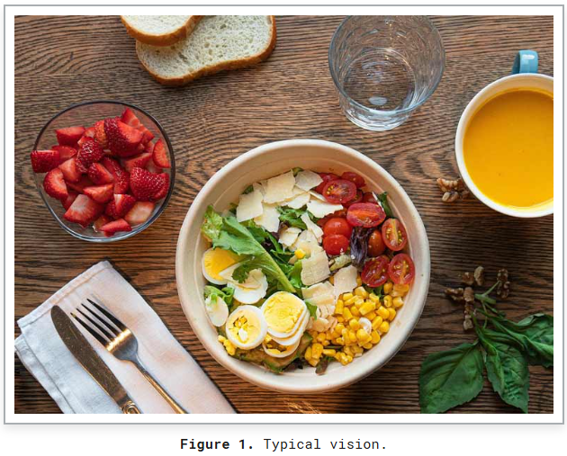
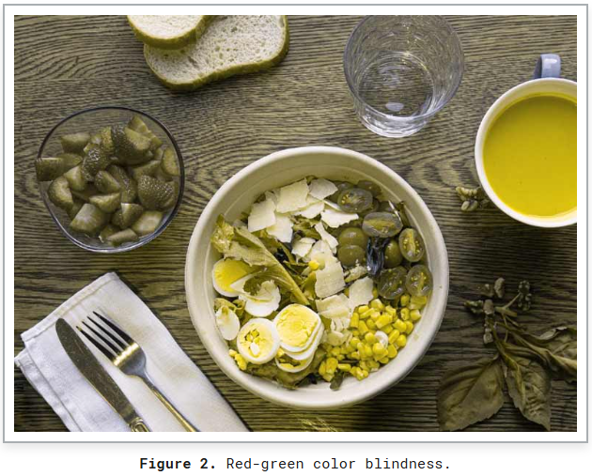
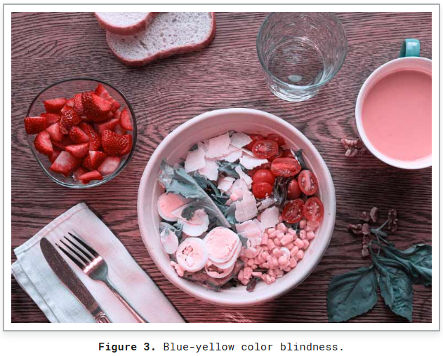
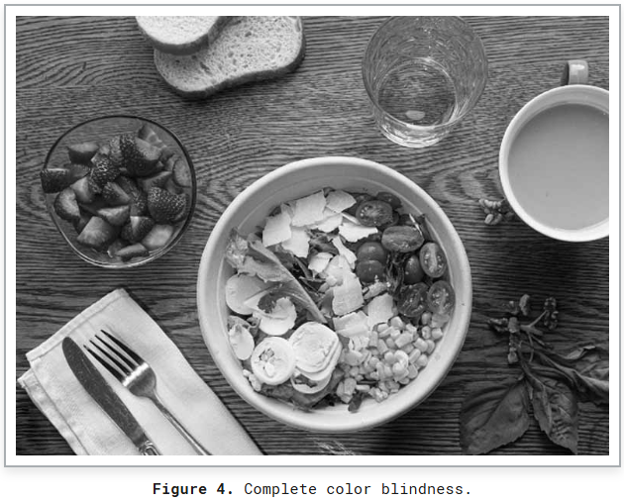
Experience: Color-Blind
How color-blind people see source: section508.gov
Typical Vision
Red-Green Color Blindness
Blue-Yellow Color Blindness
Complete Color Blindness

Slide 23
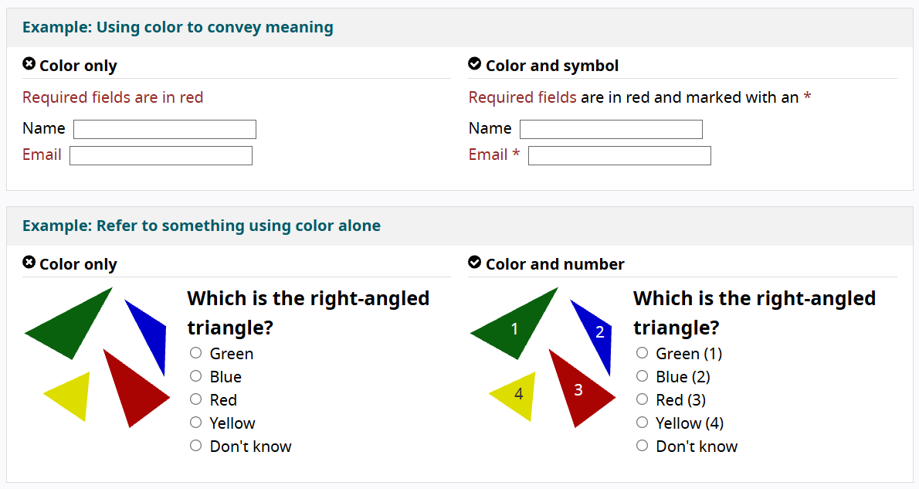
Experience: Color-Blind (cont.)
Use of color alone source: w3.org
Ensure color alone is not used to convey information like required fields or content

Slide 24
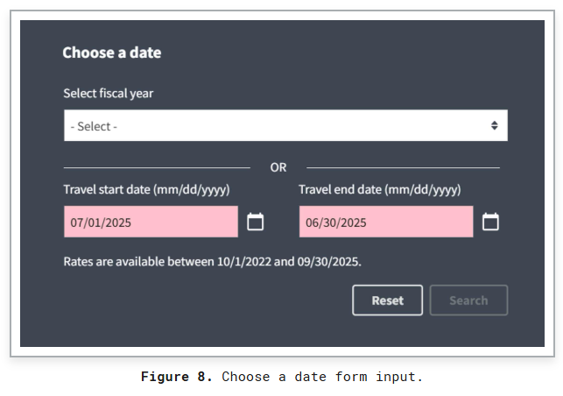
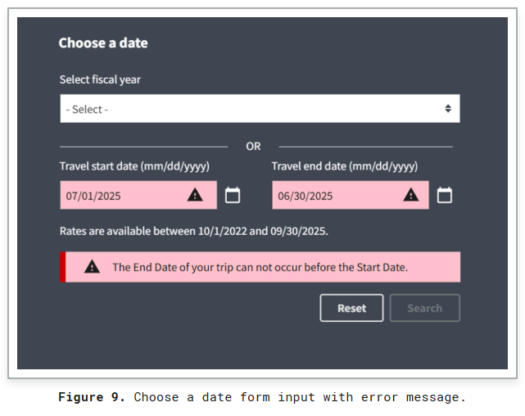
Experience: Color-Blind (cont.2)
Use of color alone in forms source: section508.gov
Form errors relying on color alone
Form errors with icons and text description

Slide 25
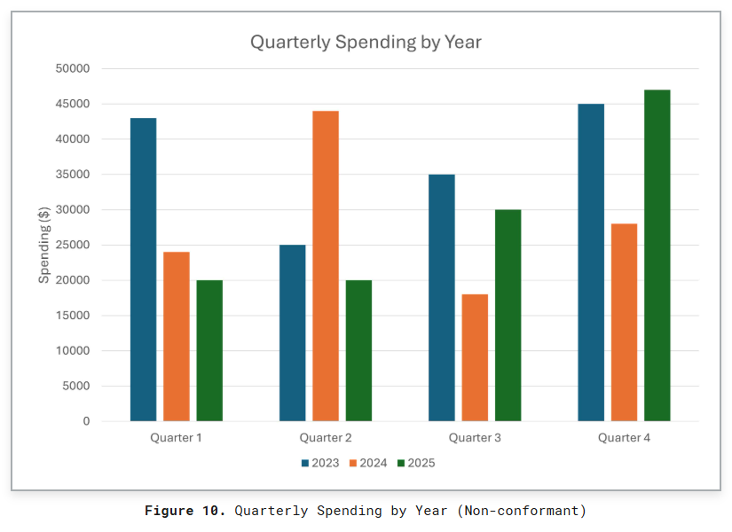
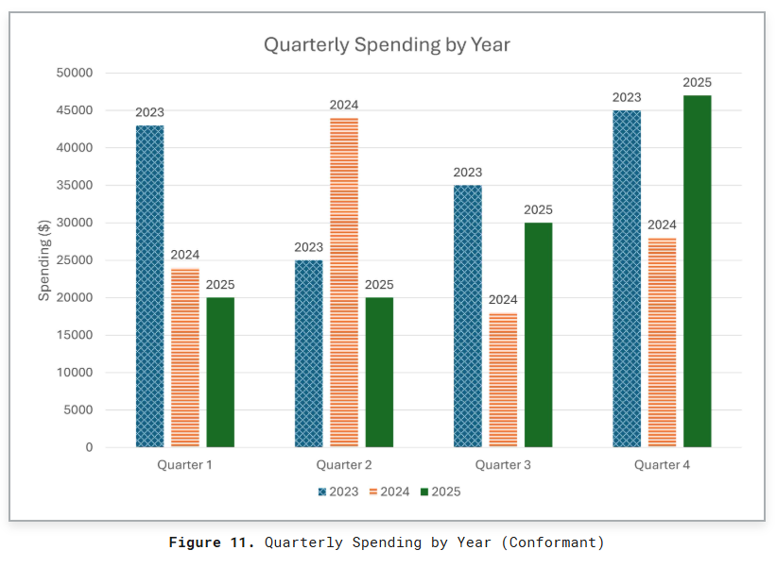
Experience: Color-Blind (cont.3)
Experience: Charts/graphs rely on color source: section508.gov
Chart that relies on color alone
Chart with texture and labels in addition to color

Slide 26
Common Scenarios: Blind
The user cannot consume the content visually.
When using screen reader technology – like JAWS, NVDA, or VoiceOver – the content must be marked up correctly, so the user can understand the purpose and relationship of each element on the page.
Often content lacks proper markup, making consuming content and completing tasks unnecessarily difficult, or sometimes impossible.

Slide 27
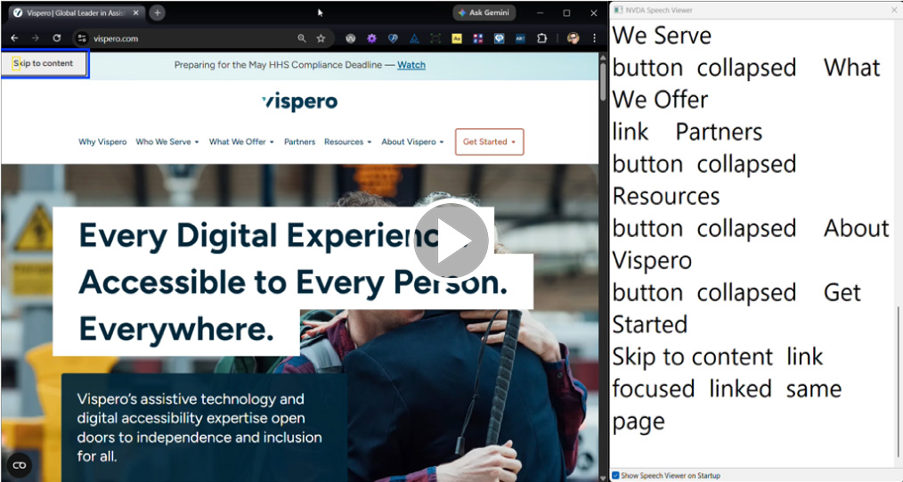
Experience: Blind
Screen Readers – like JAWS, NVDA, Windows Narrator, and VoiceOver (MacOS)
Notes:
https://www.youtube.com/watch?v=_MZOY0hVd4A

Slide 28
Common Scenarios: Deaf/deaf & Hard-of-Hearing
There is multi-media content playing, but it lacks captions or a transcript.

Slide 29
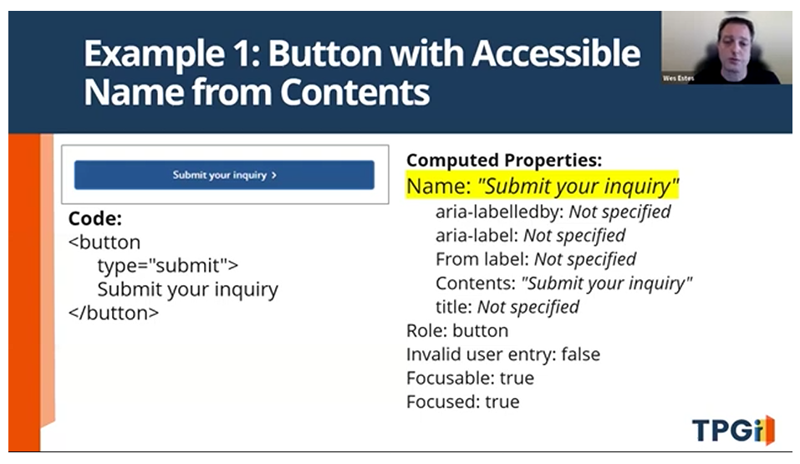
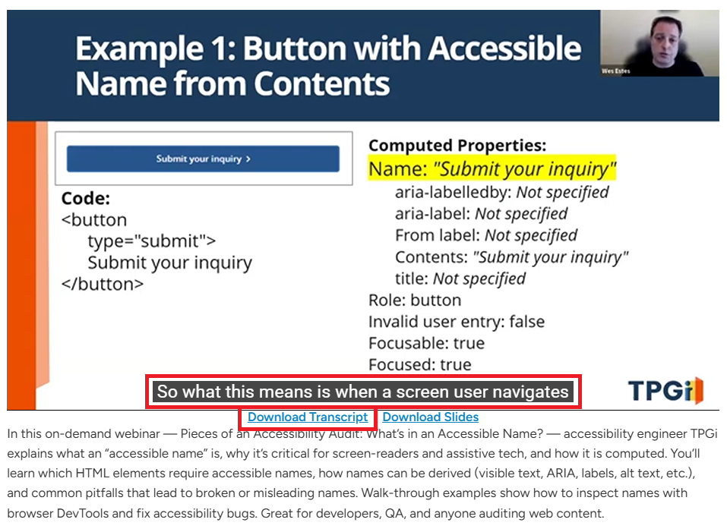
Experience: Deaf/deaf & Hard-of-Hearing
Experience: Multi-media content lacks other forms of consumption
No Captions
Captions enabled and Transcript available

Slide 30
Common Scenarios: Non-Verbal & Speech Difficulties
A website says to call a representative to complete the next step, providing no alternatives.

Slide 31
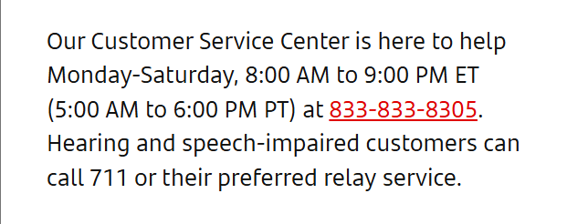
Experience: Non-Verbal & Speech Difficulties
Having an alternate method of communication – like chatbots, email, or text options – could have helped this situation.
Phone only support offered, speech-impaired customers considered but directed to 711

Slide 32
Common Scenarios: Tremors – Difficulty using mouse/touch
Smaller target sizes can be frustrating – or impossible – to interact with.

Slide 33
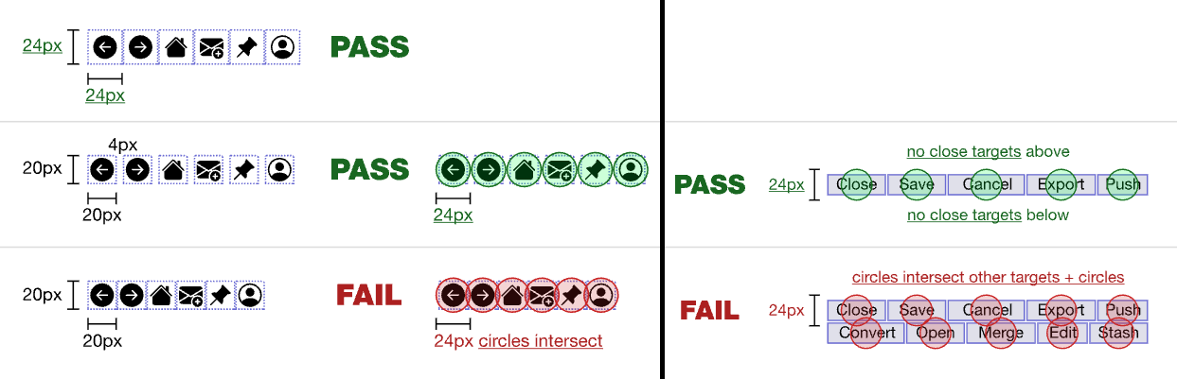
Experience: Tremors – Difficulty using mouse/touch
Smaller target sizes can be frustrating – or impossible – to interact with. source: w3.org
Placing control targets too close to each other makes clicking/tapping difficult, and can fail WCAG 2.5.8
Notes:
Tell story about gentleman with tremors who hit car in parking lot, mention programmatically associated checkboxes/form-fields

Slide 34
Common Scenarios: Keyboard only – no mouse/touch
Missing keyboard focus indicators.
Illogical or excessive tab order.
Functionality that works with a mouse doesn’t working with a keyboard only.
Notes:
Mention alternative input methods (e.g. sip and puff, speech operation, eye tracking, head wand, braille displays) typically also rely on keyboard functionality

Slide 35
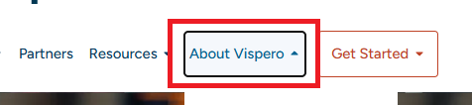
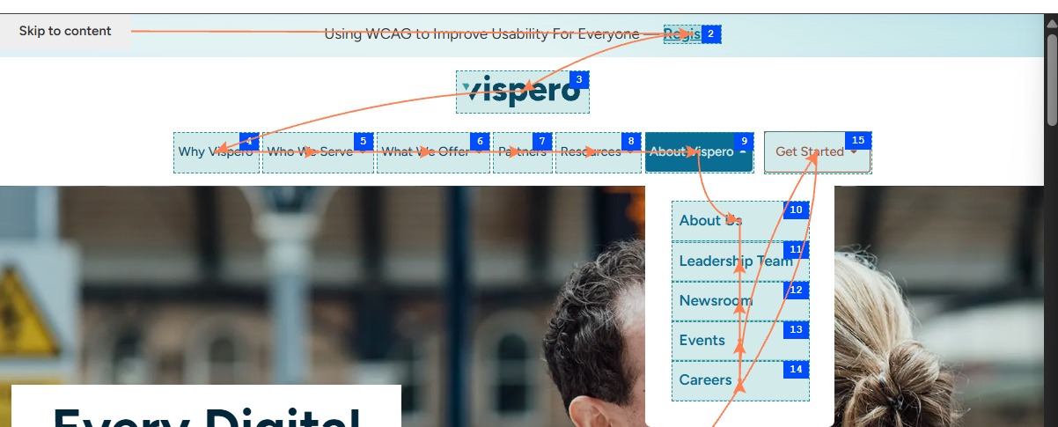
Experience: Keyboard only – no mouse/touch
Missing keyboard focus indicators.
Illogical or excessive tab order.
Visual focus indicators needed to navigate
Ensure a logical keyboard focus order
Notes:
Live Demo: Keyboard Only

Slide 36
Common Scenarios: Cognitive
Seizure Disorders
ADD
Short-Term-Memory Issues
Dyslexia
Dyscalculia
Autism
Anxiety

Slide 37
Web Q&A + Break

Slide 38
HOW do disabled people use mobile devices to interact with native mobile apps?

Slide 39
Native mobile settings and assistive technology
Let’s look at 7 scenarios:
Dark mode
Text scaling
Display zoom
Orientation
Screen reader
Speech input
Keyboard

Slide 40
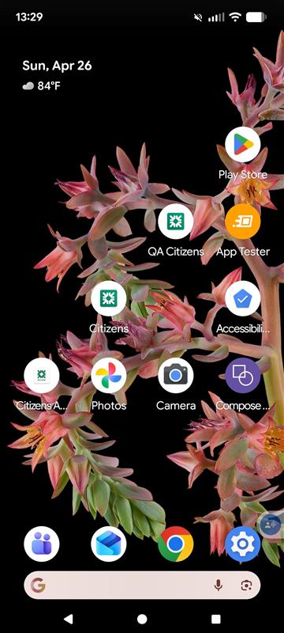
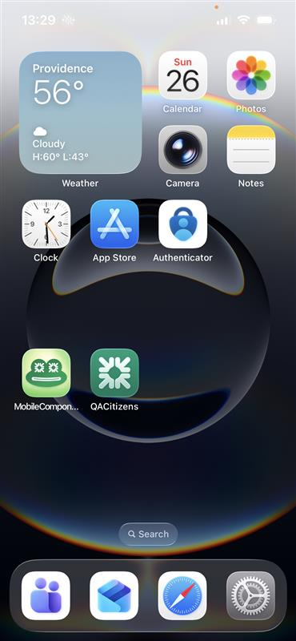
Two ecosystems
Apple iOS 26
Testing devices: iPhone 16e
Google Android 16
Testing device: Pixel 6
Notes:
Test with real devices

Slide 41
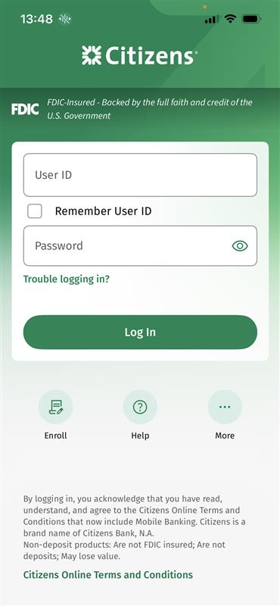
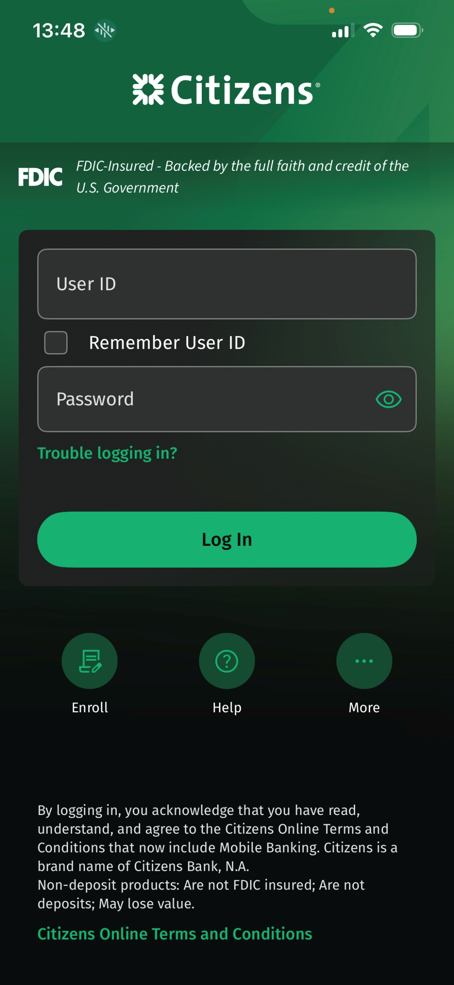
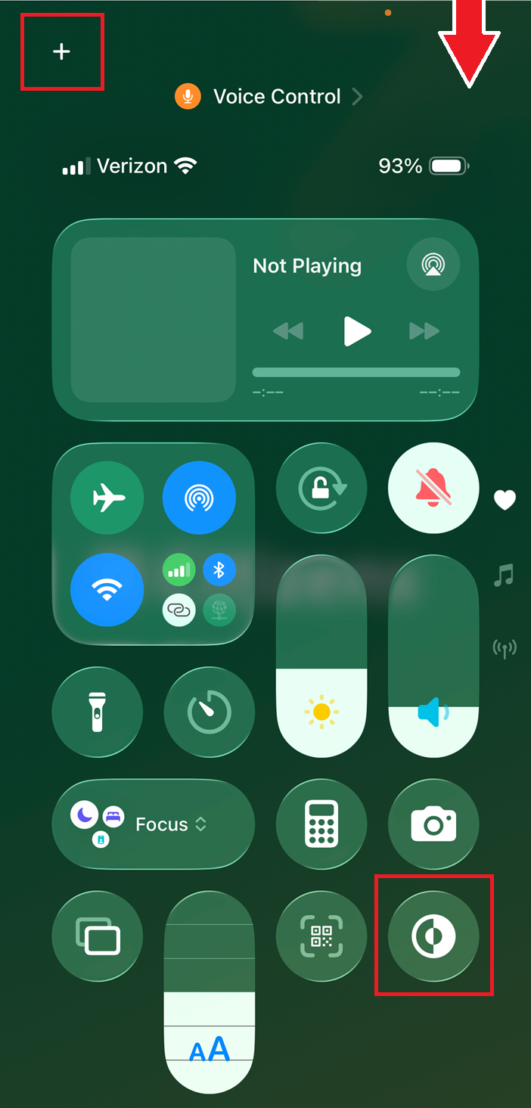
Citizens iOS app: Dark mode
Light mode
Dark mode
Control Panel

Slide 42
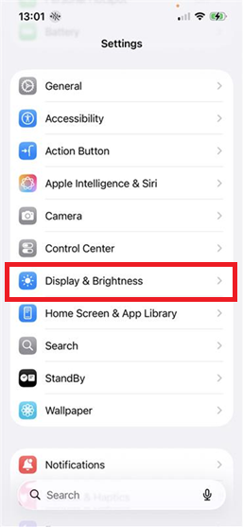
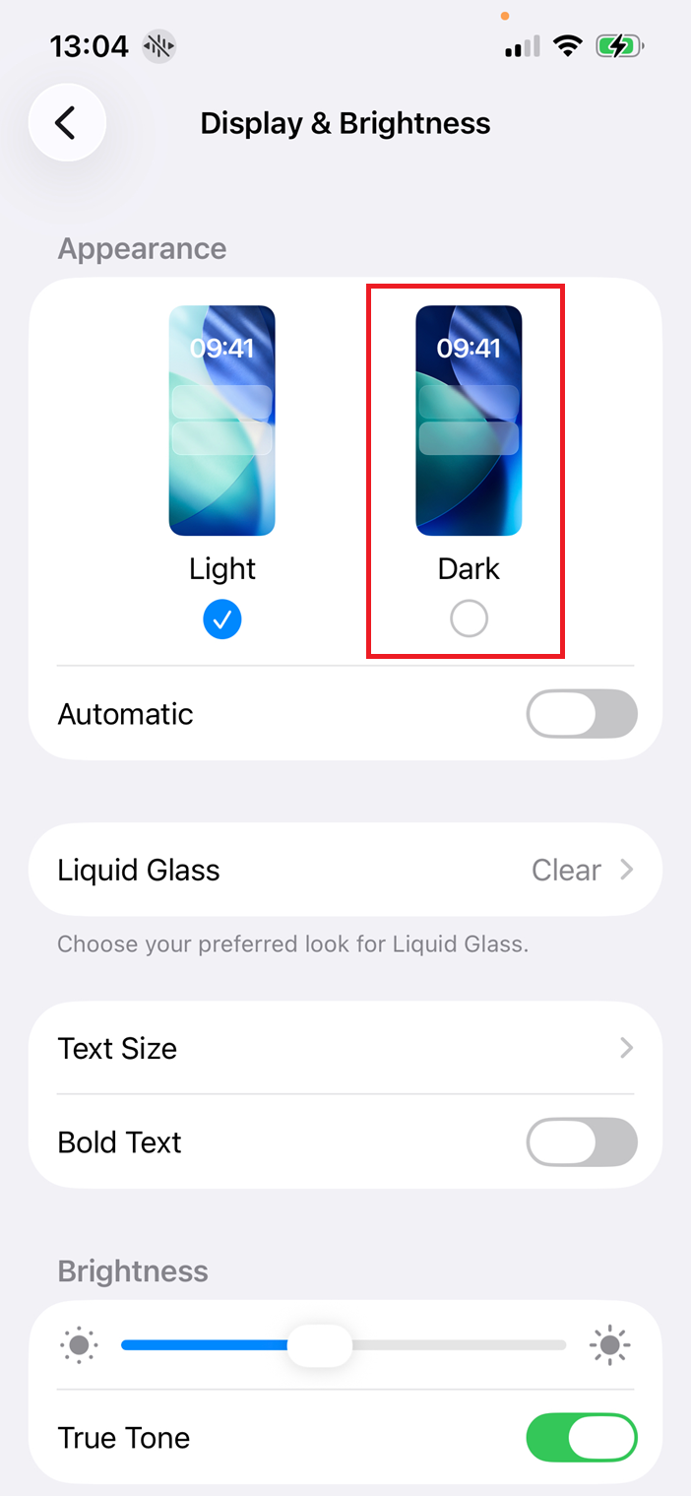
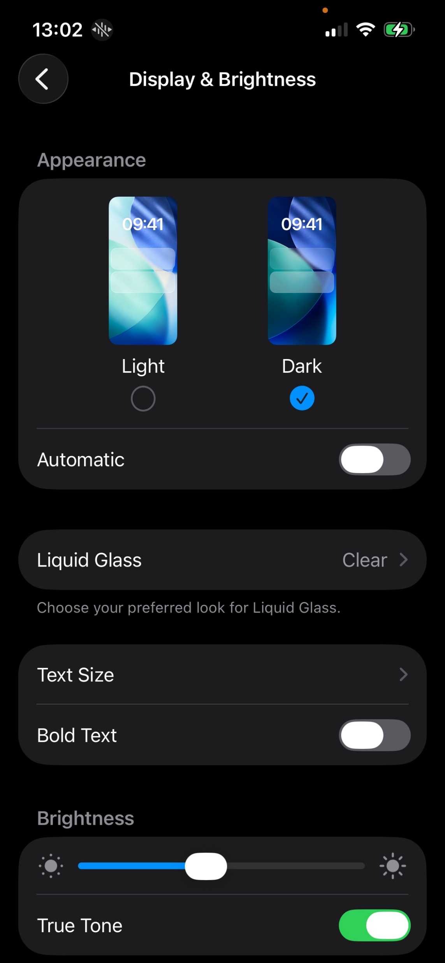
iOS: Dark mode
Settings app > Display & Brightness > Appearance > Dark radio button

Slide 43
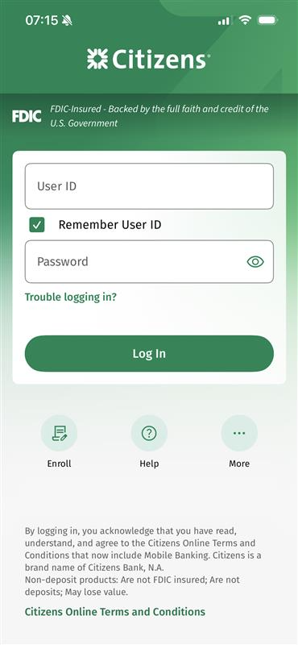
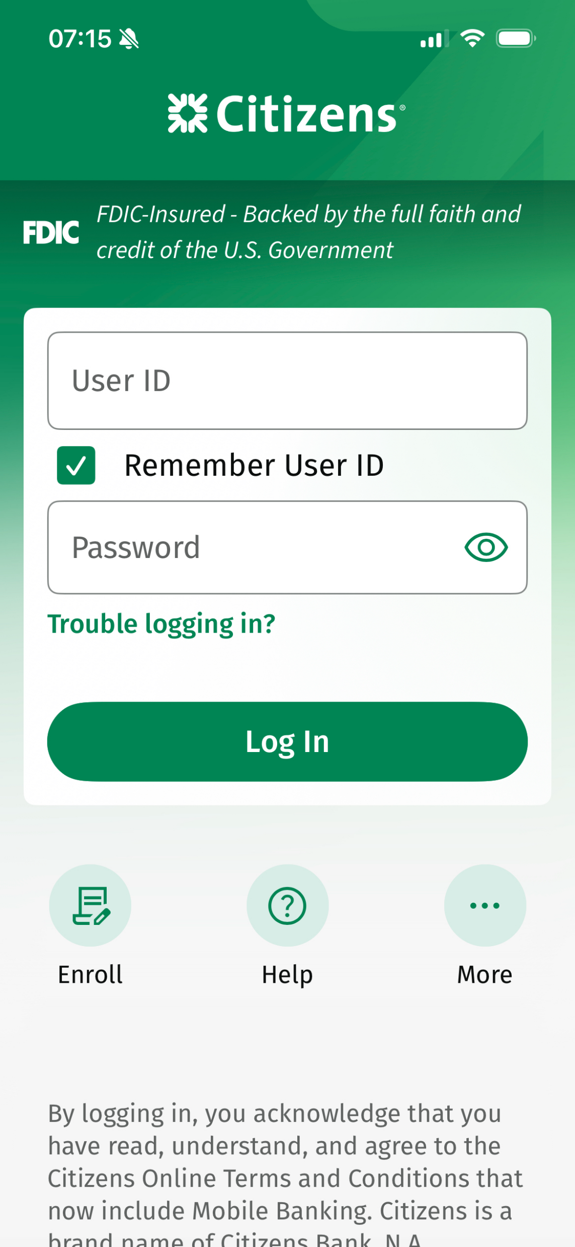
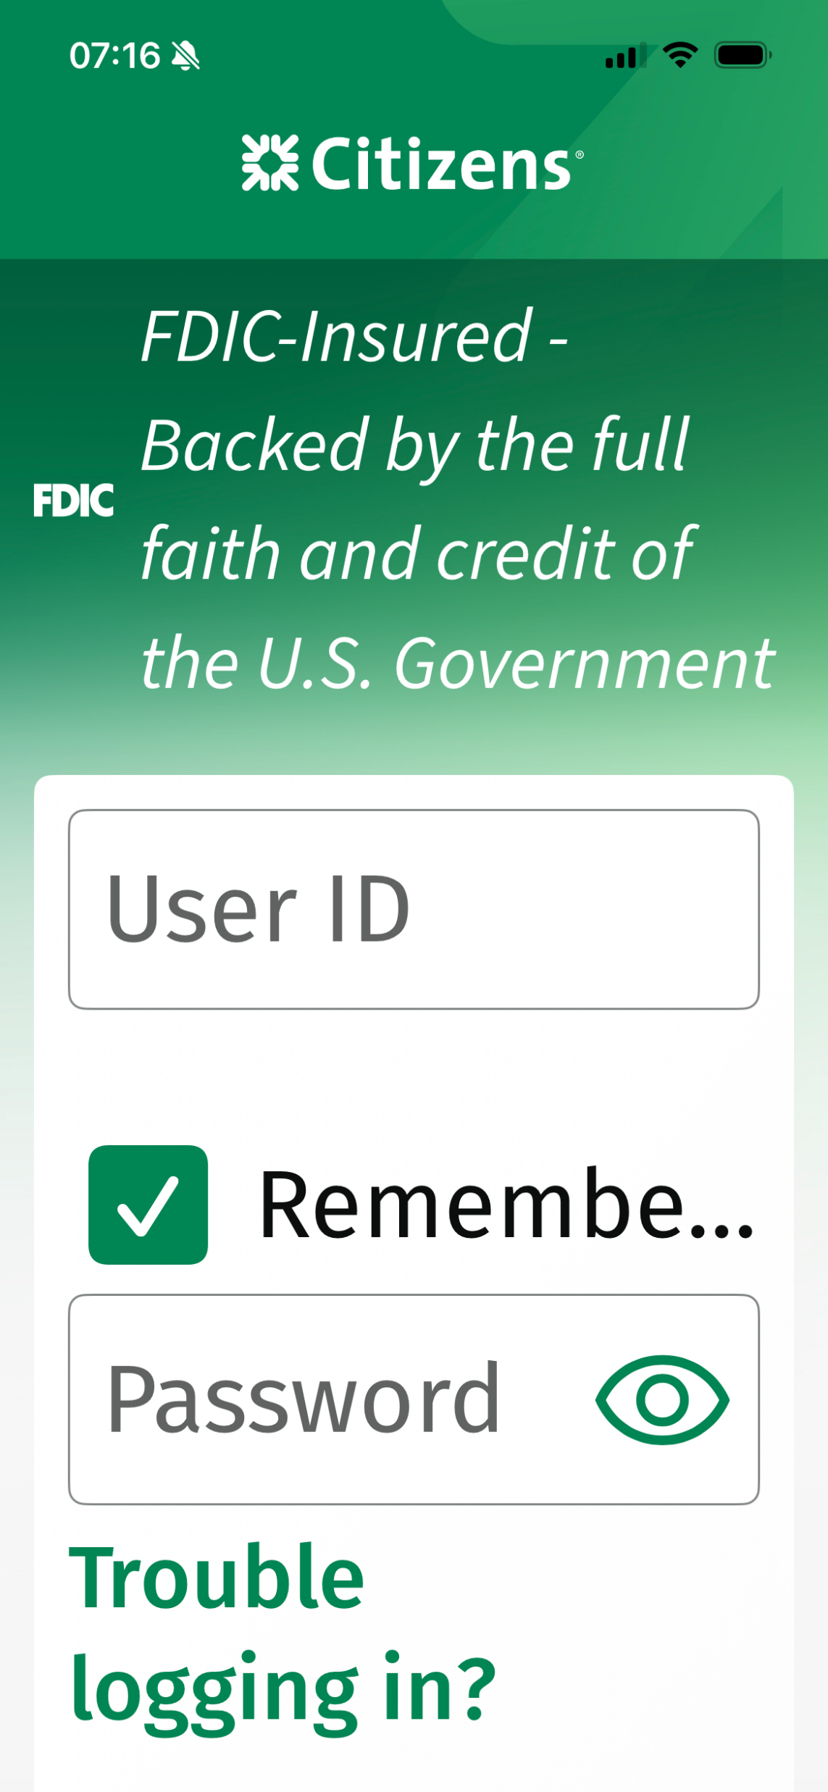
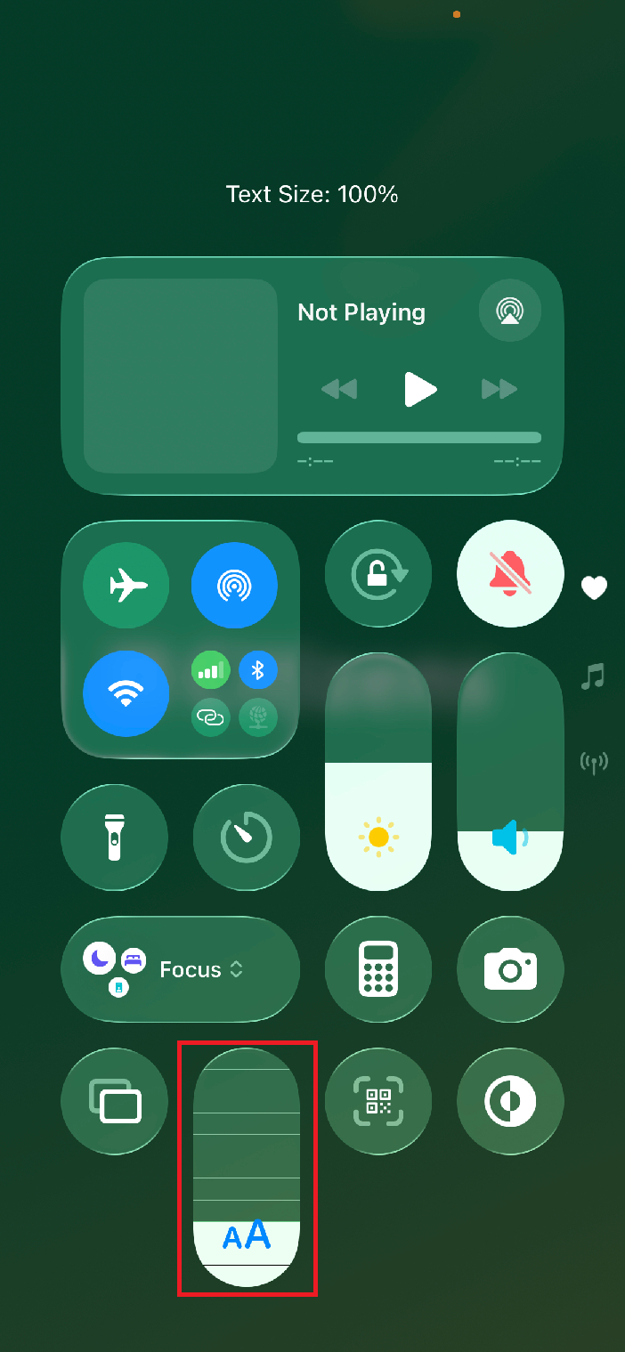
Citizens iOS app: Text scaling
Text Size: 100%
Text Size: 135%
Text Size: 310%
Control Panel
Notes:
Text sizes left to right: 100%, 135%, 310%

Slide 44
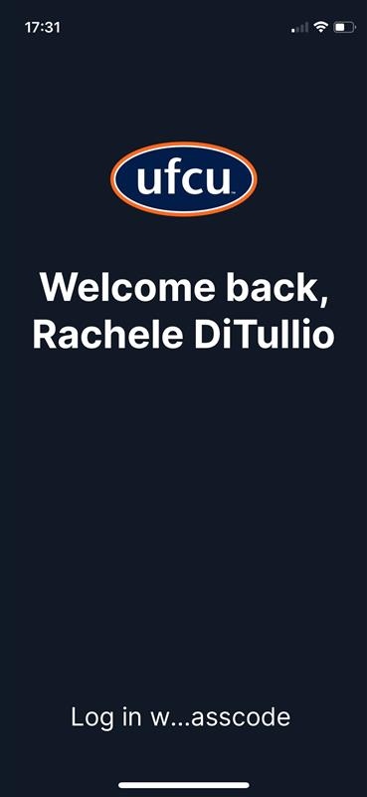
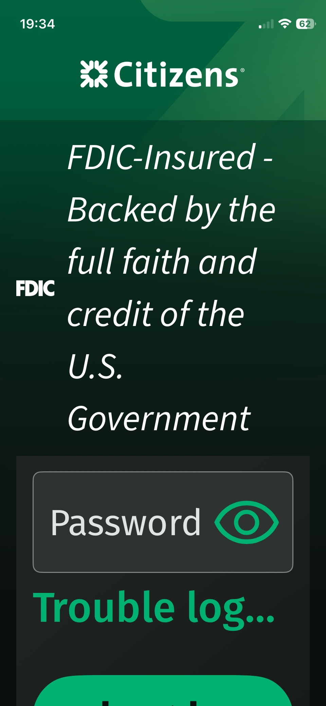
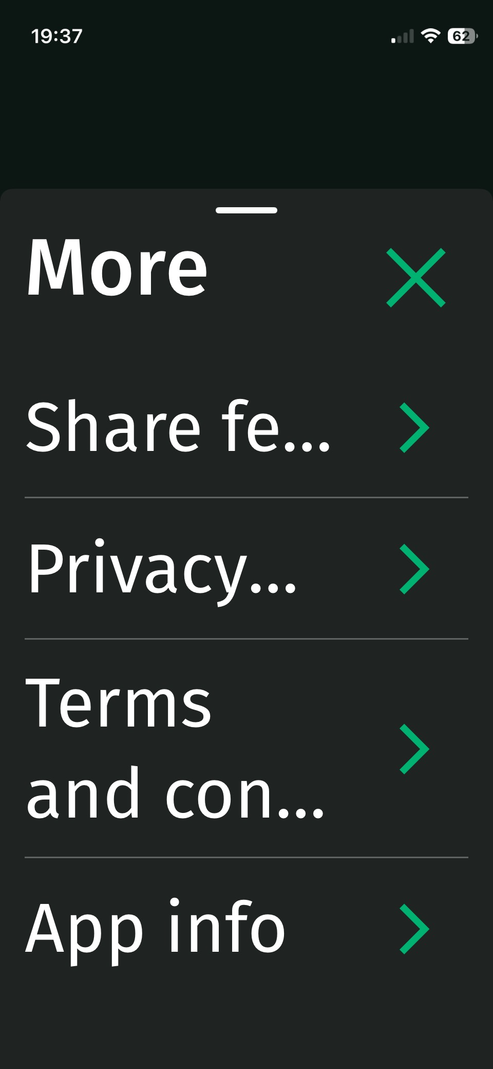
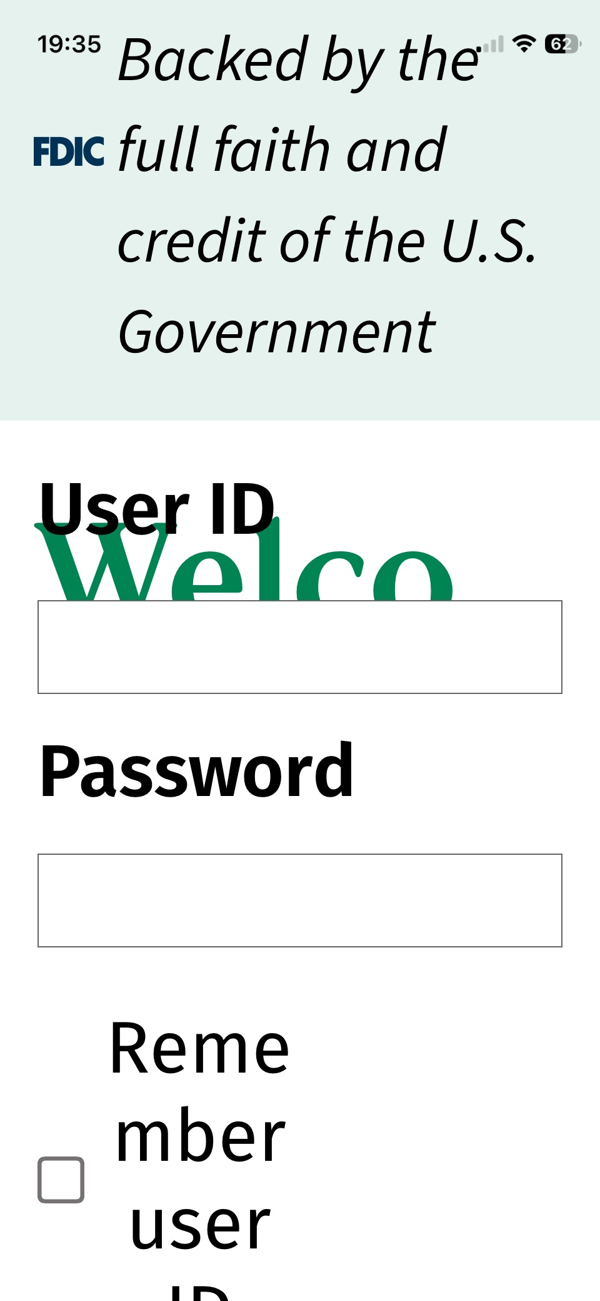
iOS text scaling not fully supported
Notes:
Text sizes left to right: 100%, 135%, 310%

Slide 45
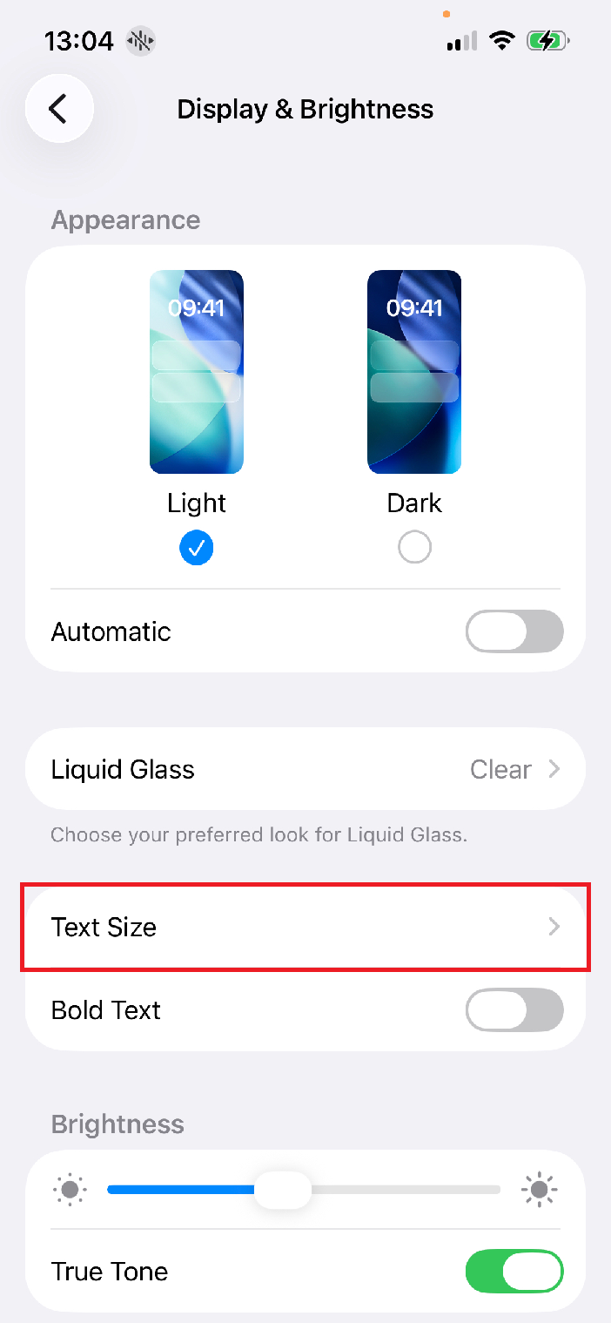
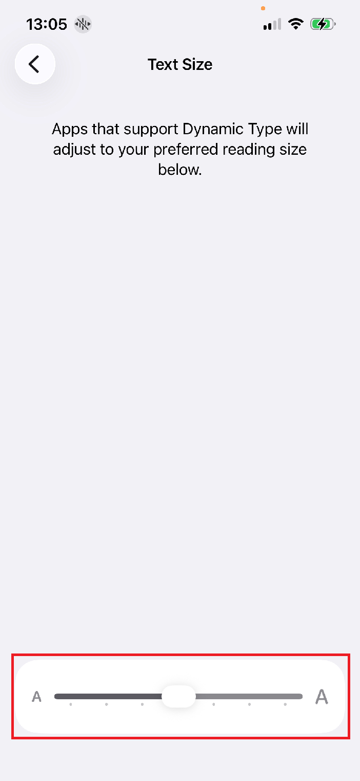

iOS: Text scaling
Settings app > Display & Brightness > Text Size > Adjust slider
Notes:
The standard largest font size is 135%.

Slide 46




iOS: Text scaling > Larger accessibility sizes
Settings app > Accessibility > Text Size > Larger Text > Larger Accessibility Sizes switch
Notes:
Max accessibility font size is 310%

Slide 47




Citizens iOS app: Display zoom
Display: Default / Text Size: 100%
Display: Larger Text / Text Size: 100%
Display: Default / Text Size: 135%
Display: Larger Text / Text Size: 135%

Slide 48



iOS: Display zoom
Settings app > Display & Brightness > Display Zoom > Larger Text radio button

Slide 49

Citizens iOS app: Screen reader video
Notes:
https://youtube.com/shorts/WxLYBPK_vs4

Slide 50




iOS: Screen reader (VoiceOver)
Settings app > Accessibility > VoiceOver > VoiceOver switch
Double-tap to activate
Notes:
Don’t enable any assistive technology without knowing how to disable it first!

Slide 51


iOS: Accessibility shortcut
Settings app > Accessibility > Accessibility Shortcut > Select VoiceOver
Using VoiceOver
Triple-click the side button to turn VO on or off
Double-tap to activate buttons and controls
Swipe right to move forwards in the reading order
Swipe left to move backwards in the reading order

Slide 52



Citizens iOS app: Speech input
Using Voice Control
Say: Tap $Name
Say: Tap $Number
Say: Stop listening / start listening
Tell Siri to enable / disable Voice Control
Show names
Show numbers
Show grid

Slide 53



iOS: Speech input (Voice Control)
Settings app > Accessibility > Voice Control > Voice Control toggle
Notes:
Don’t enable any assistive technology without knowing how to disable it first!

Slide 54

Citizens iOS app: Keyboard video
Notes:
https://youtube.com/shorts/cev7EJgzLzE

Slide 55



iOS: Keyboard
Settings app > Accessibility > Keyboards & Typing > Full Keyboard Access > Full Keyboard Access switch
Notes:
Don’t enable any assistive technology without knowing how to disable it first!

Slide 56



Native mobile apps should respond to device orientation

Slide 57
Mobile Q&A

Slide 58



Citizens Android app: Dark mode
Light mode
Dark mode
Notification panel

Slide 59



Android: Dark mode
Settings app > Display & touch > Dark theme switch

Slide 60




Citizens Android app: Text scaling
Text Size: Smallest
Text Size: Default
Text Size: Largest
Notifications Panel

Slide 61




Android: Text scaling
Settings app > Display & touch > Display size & text > Adjust Font size slider
Notes:
The standard largest font size is 135%.

Slide 62




Citizens Android app: Display zoom
Display: Smallest / Text Size: 100%
Display: Largest / Text Size: 100%
Display: Smallest / Text Size: Largest
Display: Largest / Text Size: Largest

Slide 63




Android: Display zoom
Settings app > Display & touch > Display size & text > Adjust Display size slider

Slide 64

Citizens Android app: Screen reader video
Notes:
https://youtube.com/shorts/eScJ7dfjmoc

Slide 65




Android: Screen reader (TalkBack)
Settings app > Accessibility > TalkBack > Use TalkBack switch and TalkBack shortcut switch
Double-tap to activate
Notes:
Don’t enable any assistive technology without knowing how to disable it first!

Slide 66



Citizens Android app: Speech input
Using Voice Access
Say: Tap $Label
Say: Tap $Number
Say: Stop listening
Show labels
Show numbers
Show grid

Slide 67



Android: Speech input (Voice Access)
Settings app > Accessibility > Voice Access > Voice Access shortcut toggle > Voice Access shortcut button
Notes:
Don’t enable any assistive technology without knowing how to disable it first!

Slide 68

Citizens Android app: Keyboard video
Notes:
https://youtube.com/shorts/cGY-B1NLaSI

Slide 69




Android: Keyboard
Pair and connect a Bluetooth keyboard to the device.

Slide 70
WHY does this matter?

Slide 71
WHY does this matter? (slide)
~15-30% of the average population has some sort of disability, with that number increasing with age.
Knowing WHAT kinds of disabilities exist and HOW those users interact with content allows you to understand WHY the way content is designed, developed, and released to production matters.
Inaccessible content can range from a minor inconvenience to a complete blocker. Sometimes that means a user can’t perceive your instructions, complete filling out a form, buy a widget, read class materials, finish a job application, or even log into their own bank account.
Considering visual, functional, and interactive design can make your experience better for everyone and annotations remove ambiguity going into development.
Ensuring content is coded accessibly results in fewer issues going into QA and UAT, avoiding delays going to production and expensive re-work.
Failure to consider users accessibility needs early and often in your SDLC leads to a less robust product with more inaccessible experiences ostracizing potentially large percentages of the population. Which is a problem morally, financially, and potentially legally.

Slide 72
Additional Q&A

Slide 73
Thank you + Contact info
Thank you for joining us today!​
Please feel free to connect with us:​
​
Wesley Estes (Accessibility Engineer – Expert Services at Vispero/TPGi)​
Wesley’s AccessU instructor page
Wesley’s Linkedin​
​
Rachele DiTullio (Senior Accessibility Engineer – Citizens)
Rachele’s AccessU instructor page
Rachele's Linkedin

