Slide 1
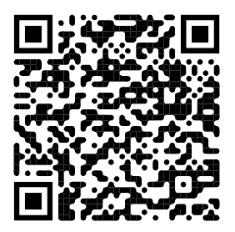
Web accessibility smoke testing for critical issues
Longhorn PHP Conference 2026
October 16 at 13:30
Rachele DiTullio, Senior Accessibility Engineer, Citizens

Slide 2
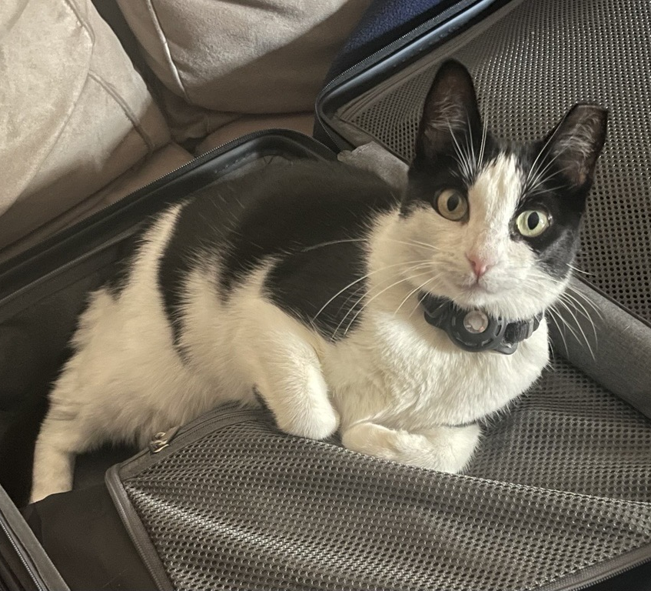
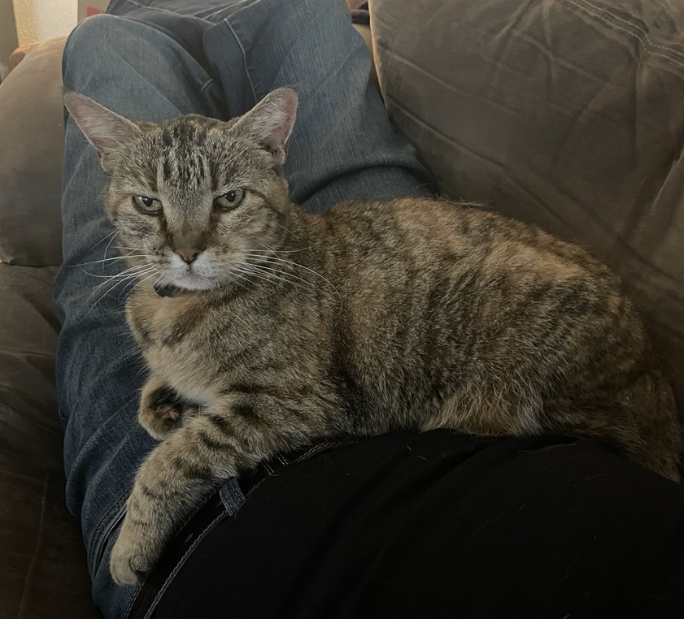
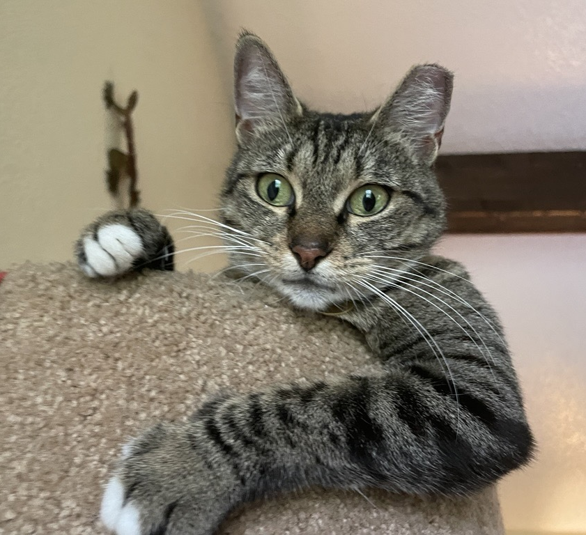
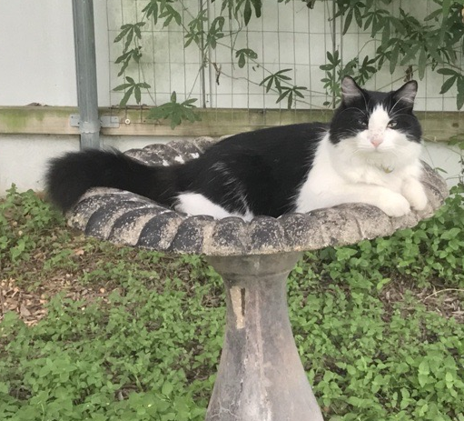
About me
Web developer for the first half of my career
MSIS from the UT Austin School of Information (UXD)
Learned accessibility and became a Certified Professional in Web Accessibility (CPWA)
Transitioned from software engineering to accessibility engineering in 2021

Slide 3
What we’ll cover today
Web accessibility overview
Smoke test 1: Use a keyboard
Testing for accessibility
Smoke test 2: Check text and UI scaling
Resources

Slide 4
Web accessibility overview

Slide 5
What is web accessibility?
Web accessibility is the extent to which
disabled people can use a website or application.
Accessibility is a benchmark of product quality.
Less
More

Slide 6
Accessibility is not only a compliance or legal issue
It’s a human one.
Disabled people will try to use our websites and web applications.
Who is being excluded by our design and development decisions?
How well do we understand the information and assistive technology needs of our disabled customers?

Slide 7
Accessibility testing by developers is impactful
Developers can catch 90% of critical blocker accessibility issues with just a few quick checks.

Slide 8
Accessibility critical blockers
Critical accessibility issues cause web content or functionality to be completely inaccessible to some users.
A video without captions or a transcript available
A button that can only be clicked with a mouse
A link that doesn’t work with the enter key
A page where nothing has a visible indication of keyboard focus
Content that is not available on smaller screens or when zoomed
Etc., this is not an exhaustive list

Slide 9
Cost of accessibility defects
On average, each accessibility defect costs about $2600 in potential ROI to fix.
(Source: Karl Groves)
Notes:
Based on a developer cost of $67/hour

Slide 10
Web accessibility standards
Web Content Accessibility Guidelines (WCAG) version 2.2
success criteria are used to evaluate whether components and webpages are accessible.
ISO standard: ISO/IEC 40500:2025
WCAG 2.2 has 55 success criteria at Levels A and AA.
Web smoke testing covers 6 success criteria.

Slide 11
Smoke test 1: Use a keyboard

Slide 12
If you can do only one thing for accessibility
Make your application work with a keyboard.
If it works with a keyboard, it will likely work with assistive technologies, like screen readers, for free.

Slide 13
Four keyboard checks to smoke test
Ensure all actions can be performed with a keyboard
Ensure there are no keyboard traps
Ensure the keyboard focus order is logical
Ensure keyboard focus is visible

Slide 14
Check #1: Ensure all actions can be performed with a keyboard
Goal: Everything can be done with a keyboard except freehand movements.
What to do: Ensure pointer actions have a keyboard equivalent.
Why it's important: Many people rely on the keyboard interface, including blind and some mobility impaired people.
Success criterion: 2.1.1 Keyboard

Slide 15
Basic keyboard navigation commands
Description | Command
Go to the next interactive element | tab
Go to the previous interactive element | shift + tab
Activate a button | enter or space
Activate a link | enter
Select a radio button, tab, list item, etc., scrolling | arrow keys (When in doubt, try these.)
Select a checkbox | space
Close dialogs, expanded content | esc

Slide 16
Mac users: Enable Full Keyboard Access
By default, you cannot navigate webpages on MacOS using standard keyboard navigation commands.
Choose Apple menu > System Settings; then click Accessibility in the sidebar.
Choose Motor > Keyboard in the Accessibility menu.
Toggle on the switch for "Full Keyboard Access".
Safari: Settings > Advanced. Under Accessibility, tick the checkbox for "Press Tab to highlight each item on a webpage".

Slide 17
Check #2: Ensure there are no keyboard traps
Goal: Keyboard users don't get stuck.
What to do: Ensure users always know how to navigate away from components.
Why it's important: People who rely on the keyboard often have no other means to navigate.
Success criterion: 2.1.2 No Keyboard Trap
Notes:
If you can tab to it, you can tab away from it.

Slide 18
Check #3: Ensure the keyboard focus order is logical
Goal: Keyboard users navigate content in a correct order.
What to do: Elements receive focus in an order that preserves meaning.
Why it's important: Navigating a site or application with only the keyboard will make sense.
Success criterion: 2.4.3 Focus Order
Notes:
Focus should move left to right, top to bottom following the natural reading order

Slide 19
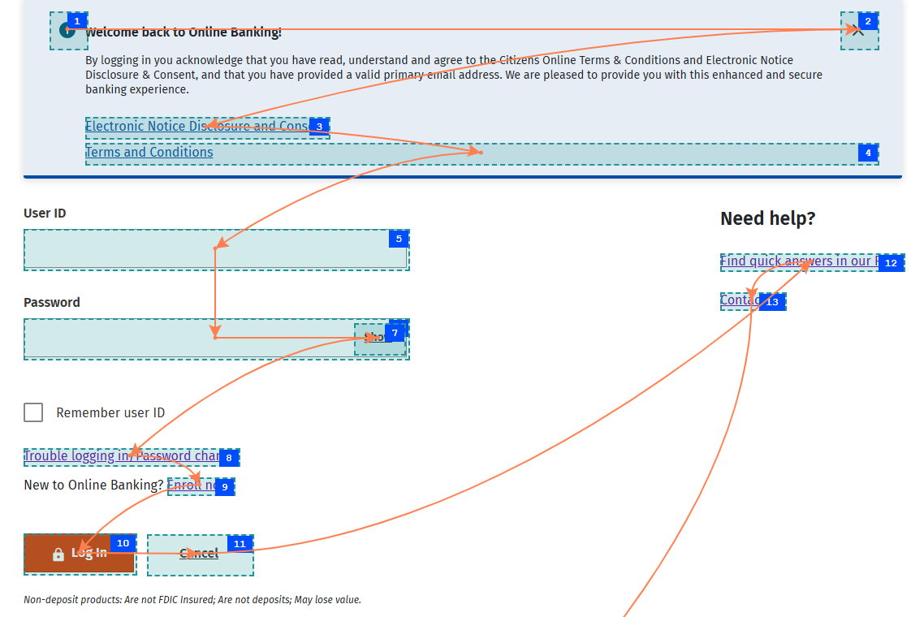
Keyboard focus order
Icon should not be in the focus order.
Checkbox should be in the focus order.
Notes:
ARC Toolkit Chrome extension

Slide 20
Check #4: Ensure keyboard focus is visible
Goal: Users know which element has keyboard focus.
What to do: Ensure each item receiving focus has a visible indicator.
Why it's important: Without a focus indicator, sighted keyboard users cannot operate the page.
Success criterion: 2.4.7 Focus Visible

Slide 21
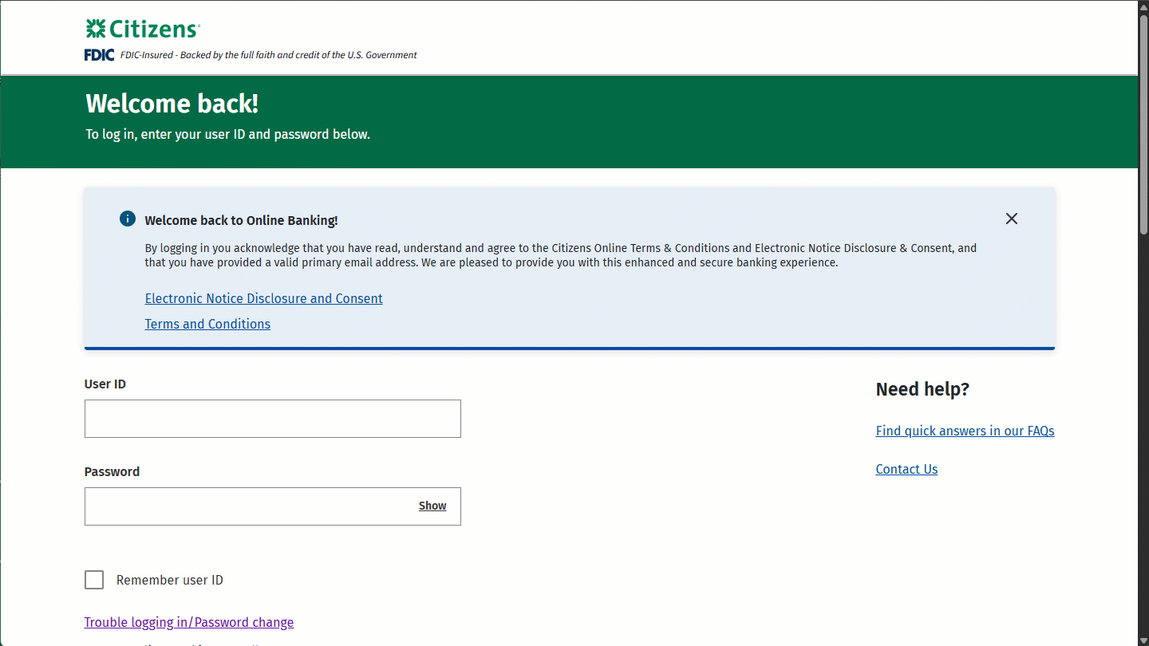
Keyboard focus indicators

Slide 22
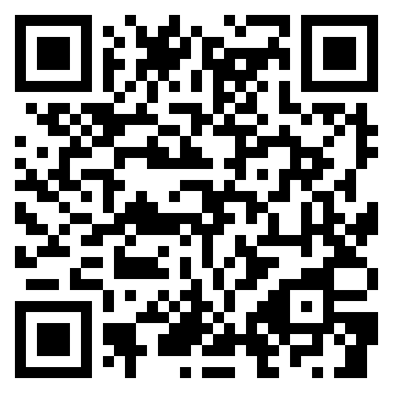
HTML elements that receive keyboard focus
Commonly used elements
Link
Button
Text input (email, password, tel, url)
Select and option
Radio button
Checkbox
Text area
File input
Reset button
Submit button
Summary
iframe
Custom components
Add keyboard focus with the tabindex="0" attribute.
Less used elements
Search input
Range input (slider)
Date input
Time input
Number input
Etc.
CodePen example
Notes:
https://codepen.io/racheleditullio/pen/EaNXPaP

Slide 23
Smoke test 2: Check text and UI scaling

Slide 24
All webpages must resize text and reflow content
Adaptive content helps people viewing webpages on smaller mobile device screens and people who have scaled the browser or OS settings to view text and content at larger sizes.
MacOS browser zoom
Press command + to increase zoom level.
Press command - to decrease zoom level.
Press command 0 to reset zoom level to 100%.
Windows browser zoom
Press ctrl + to increase zoom level.
Press ctrl - to decrease zoom level.
Press ctrl 0 to reset zoom level to 100%.

Slide 25
Check #5: Ensure text resizes 200% in a 1024x768 viewport
Goal: Text can be enlarged.
What to do: Ensure text can be doubled in size.
Why it's important: Some people can only read text when it is bigger.
Success criterion: 1.4.4 Resize Text

Slide 26
Check #6: Ensure content reflows in a 320x256 viewport
Goal: Content can be enlarged without increasing line length.
What to do: Make lines of text reflow within the viewport.
Why it's important: People who need bigger text find it difficult if they must scroll to read long lines.
Success criterion: 1.4.10 Reflow
Notes:
Download the Window Resizer Chrome extension

Slide 27
Check the webpage for resized text and reflowed content
Is there a meaningful change in the text displayed onscreen?
All text should scale up or down linearly.
Does any content overlap or run oﬀ the screen?
No content should overlap, and text should either wrap or (in some limited cases) be truncated. In cases where text wraps, containers should be scrollable if there is a height constraint; text and webpages should not scroll horizontally. Text should not run oﬀ the screen altogether.
Does the screen still make sense?
There should still be some visual hierarchy in the relationships between headings, paragraphs of text, graphics, controls and other elements on the screen.

Slide 28
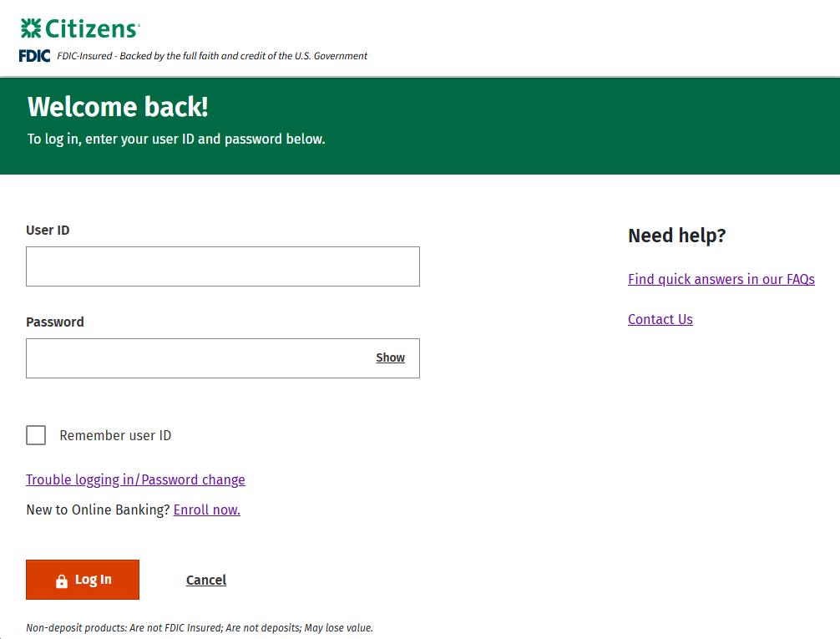
100% zoom in a 1024x768 viewport

Slide 29
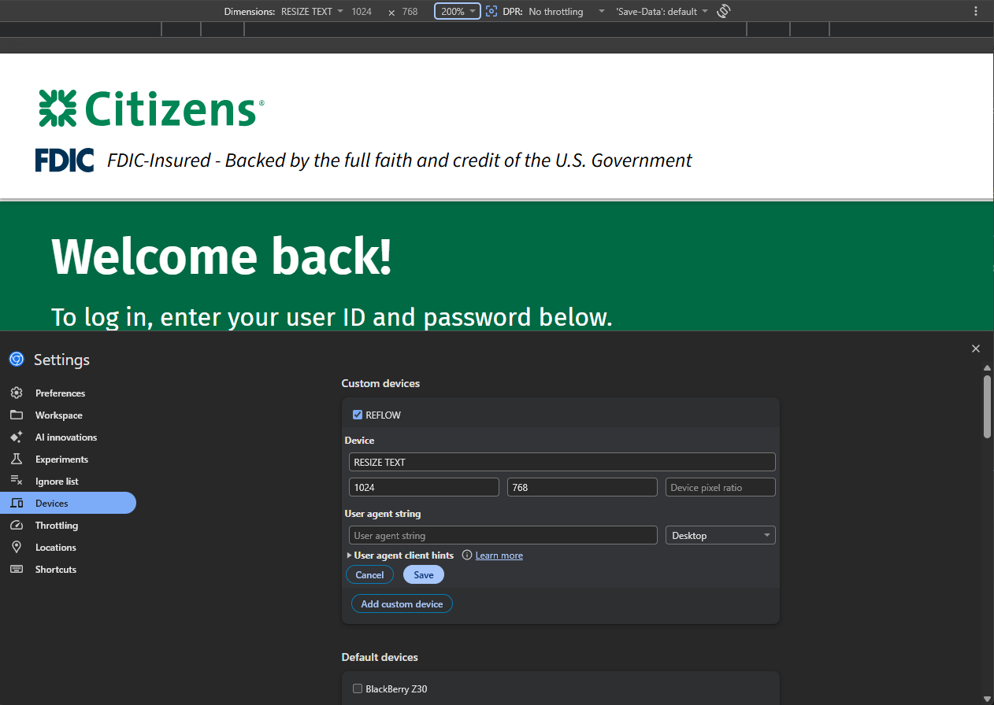
Chrome emulator: 1024x768 viewport at 200% zoom

Slide 30
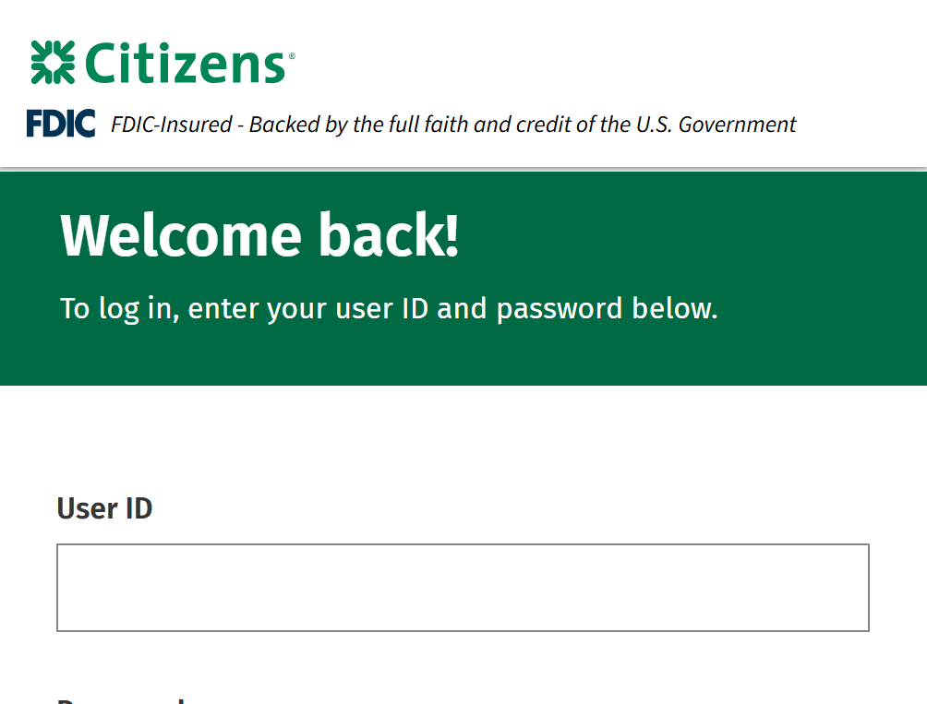
Resize text: 200% zoom in a 1024x768 viewport
Notes:
Window Resizer Chrome extension

Slide 31
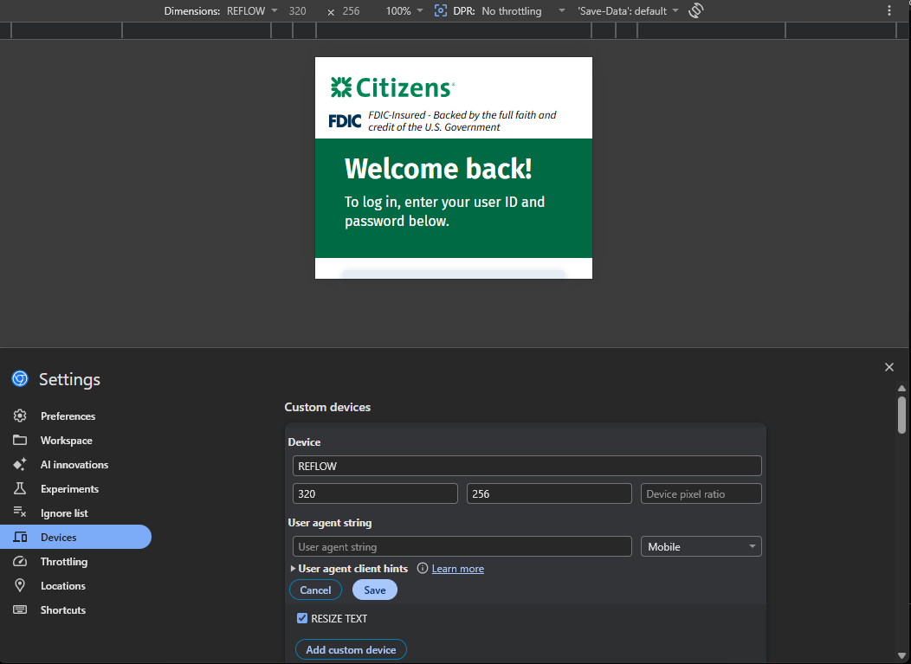
Chrome emulator: 320x256 viewport at 100% zoom

Slide 32
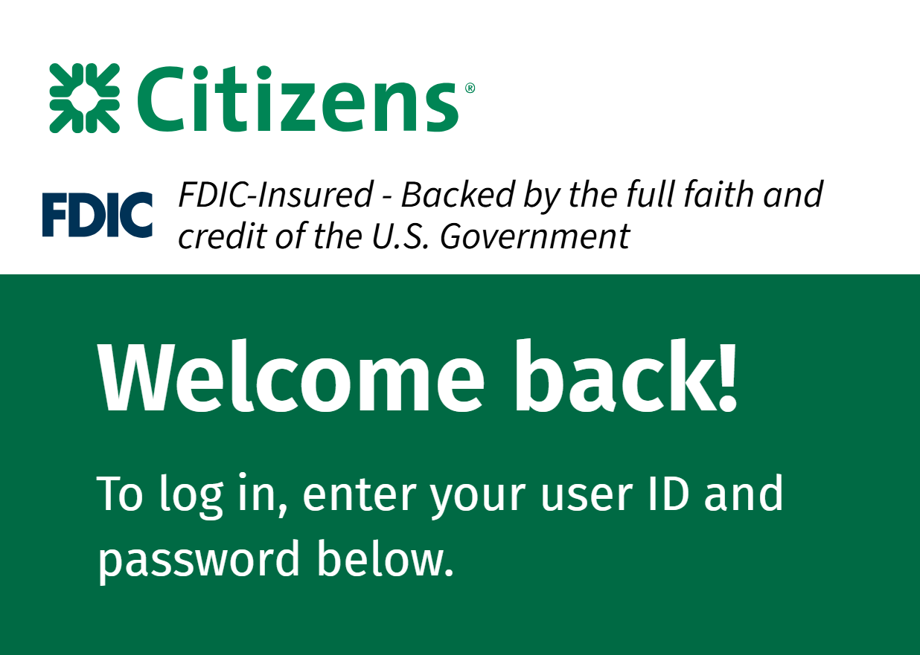
Reflow: 320x256 viewport = 400% zoom in a 1280x1024 viewport
Notes:
Window Resizer Chrome extension

Slide 33
Smoke testing summary: 6 quick checks
Can all actions can be performed with a keyboard?
Are there are any keyboard traps?
Is the keyboard focus order logical?
Is keyboard focus visible for all interactive elements?
Can text resize 200% in a 1024x768 viewport?
Can content reflow in a 320x256 viewport?

Slide 34
Thank you
Download slides
Blog article of this talk
Contact me
https://RacheleDiTullio.com/

